Slide 1
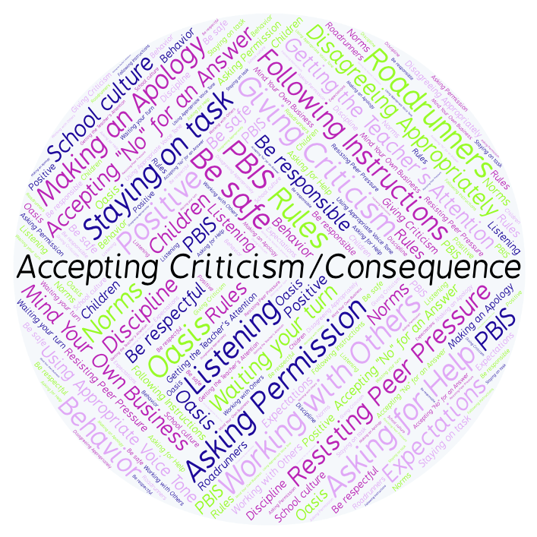
PBIS Social Skills
Day 1

Slide 2
Accepting Criticism or a Consequence
Who have you had to accept criticism or a consequence from? Why?
To respond to the prompt, scan the QR code to the right from the Padlet app or click here.
Once you have opened the Padlet, click on the plus sign ( + ) in the bottom right hand corner and enter your response.
Look around the Padlet to see what others have said.

Slide 3
Accepting Criticism or a Consequence
This week we are going to talk about Accepting Criticism or a Consequence.
Let’s learn the three steps all students must do when asked to accept criticism or a consequence.

Slide 4
Accepting Criticism or a Consequence
Step 1: Look at the person.

Slide 5
Accepting Criticism or a Consequence
Step 2: Say “Okay.”

Slide 6
Accepting Criticism or a Consequence
Step 3: Stay calm.

Slide 7
Accepting Criticism or a Consequence
We will be practicing these steps all week.
When you use the steps to Accepting Criticism or a Consequence appropriately, you may learn how to do things better.

Slide 8
Accepting Criticism or a Consequence
Project for the Week
Work with your table group to create an AVID One-Pager.
You may create your One-Pager by hand, or consider creating it in Google Drawings.
Be sure to include all the requirements listed on the next page.
Present the poster to your class.

Slide 9
Accepting Criticism or a Consequence
Project for the Week: One-Pager Instructions
Include first and last name, clearly displayed.
Create a border that reflects Accepting Criticism or a Consequence.
Using the information you have learned this week as a beginning point, display your reactions and connections to this social skill.
Include visual images that have strong relationships to this social skill
Draw a word cluster around one of the visual images. The visual word cluster should artistically symbolize this social skill
Write a poem about someone who exemplifies this social skill.
Support your selections, your artwork and your opinions with a personal statement. Begin your statement with “I believe...”
Create Level One, Two or Three questions, and then answer them with solid support from the information you have learned this week.
Be colorful and neat.

