Slide 1
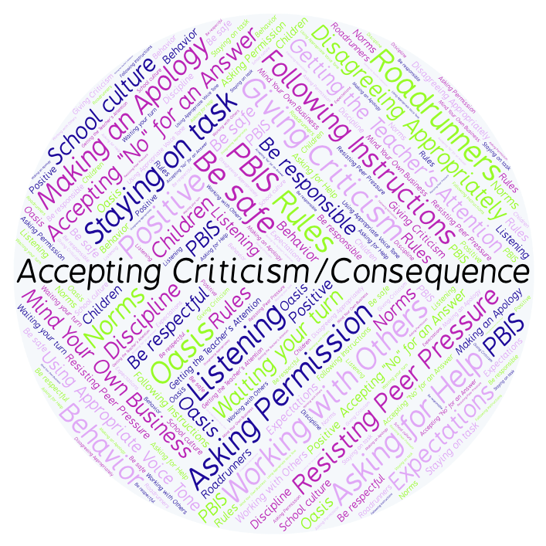
PBIS Social Skills
Day 2

Slide 2
Accepting Criticism or a Consequence
Remember, this week we are talking about Accepting Criticism or a Consequence.
Let’s review the three steps.

Slide 3
Accepting Criticism or a Consequence
Step 1: Look at the person.

Slide 4
Accepting Criticism or a Consequence
Step 2: Say “Okay.”

Slide 5
Accepting Criticism or a Consequence
Step 3: Stay calm.

Slide 6
Accepting Criticism or a Consequence
When you use the steps to Accepting Criticism or a Consequence appropriately, you may learn how to do things better.
Okay, today we are going to talk more about the first step.
Step 1 is “Look at the person.”

Slide 7
Accepting Criticism or a Consequence
Why do you think it is important to look at someone when they are giving you a criticism or a consequence?
Turn to your elbow partner and practice step 1 while you are explaining your answer to this question.

Slide 8
Accepting Criticism or a Consequence
What do you think would happen if you didn’t look at someone that was giving you criticism or a consequence?
Now turn to your elbow partner and demonstrate a non-example of this step while explaining your answer.

Slide 9
Accepting Criticism or a Consequence
Let’s see what happens when Koko learns to
accept the consequences of her actions.

Slide 10
Accepting Criticism or a Consequence
Have a discussion with your elbow partner:
In the movie you just watched, how could Koko have done a better job of accepting criticism and her consequence?
Which step do you think you need to work on the most? Why?

Slide 11
Accepting Criticism or a Consequence
Project for the Week
Work with your table group to create an AVID One-Pager.
You may create your One-Pager by hand, or consider creating it in Google Drawings.
Be sure to include all the requirements listed on the next page.
Present the poster to your class.

Slide 12
Accepting Criticism or a Consequence
Project for the Week: One-Pager Instructions
Include first and last name, clearly displayed.
Create a border that reflects Accepting Criticism or a Consequence.
Using the information you have learned this week as a beginning point, display your reactions and connections to this social skill.
Include visual images that have strong relationships to this social skill
Draw a word cluster around one of the visual images. The visual word cluster should artistically symbolize this social skill
Write a poem about someone who exemplifies this social skill.
Support your selections, your artwork and your opinions with a personal statement. Begin your statement with “I believe...”
Create Level One, Two or Three questions, and then answer them with solid support from the information you have learned this week.
Be colorful and neat.

