Slide 1
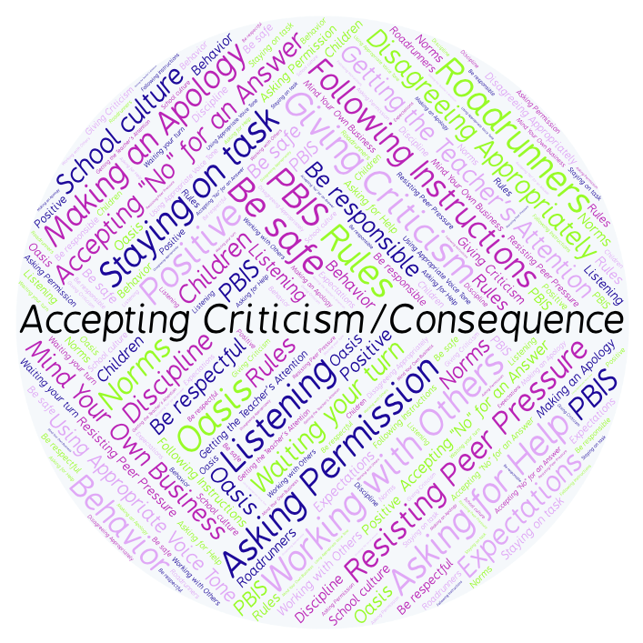
PBIS Social Skills
Day 5

Slide 2
Accepting Criticism or a Consequence
Remember, this week we are talking about Accepting Criticism or a Consequence.
Let’s review the three steps.

Slide 3
Accepting Criticism or a Consequence
Step 1: Look at the person.

Slide 4
Accepting Criticism or a consequence
Step 2: Say “Okay.”

Slide 5
Accepting Criticism or a consequence
Step 3: Stay calm.

Slide 6
Accepting Criticism or a consequence
When you use the steps to Accepting Criticism or a Consequence appropriately, you may learn how to do things better.
Okay, today we are going to present the Projects we have been working on this week. Who would like to be the first volunteer?

