Slide 1
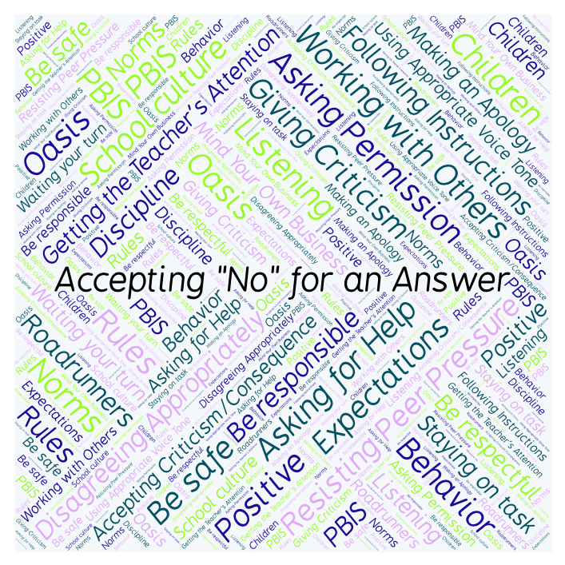
PBIS Social Skills
Day 1

Slide 2
Accepting “No” for an Answer
Why is it best to accept “no” for an answer from someone?
To respond to the prompt, scan the QR code to the right from the Padlet app or click here.
Once you have opened the Padlet, click on the plus sign ( + ) in the bottom right hand corner and enter your response.
Look around the Padlet to see what others have said.

Slide 3
Accepting “No” for an Answer
This week we are going to talk about Accepting “No” for an Answer
Let’s learn the four steps all students must do when asked to accept “no” for an answer.

Slide 4
Accepting “No” for an Answer
Step 1: Look at the person.

Slide 5
Accepting “No” for an Answer
Step 2: Say “Okay.”

Slide 6
Accepting “No” for an Answer
Step 3: Stay calm.

Slide 7
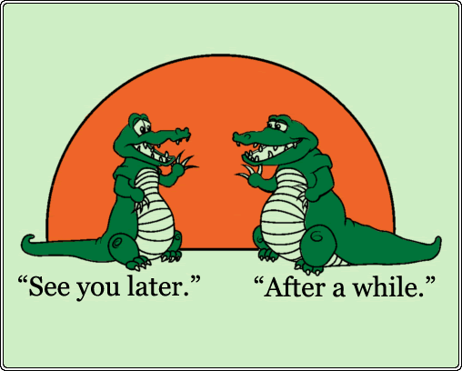
Accepting “No” for an Answer
Step 4: If you disagree, ask later.

Slide 8
Accepting “No” for an Answer
We will be practicing these steps all week.
When you are able to Accept “No” for an Answer, you are more likely to get the answer you want next time.

Slide 9
Accepting “No” for an Answer
Project for the Week
Write in your journal about a time you had to accept “no” for an answer.
Be sure to include:
a description of what happened and how you might have handled it better.
The four steps you learned for Accepting “No” for an Answer.
Consider writing your journal entry on KidBlog.

