Slide 1
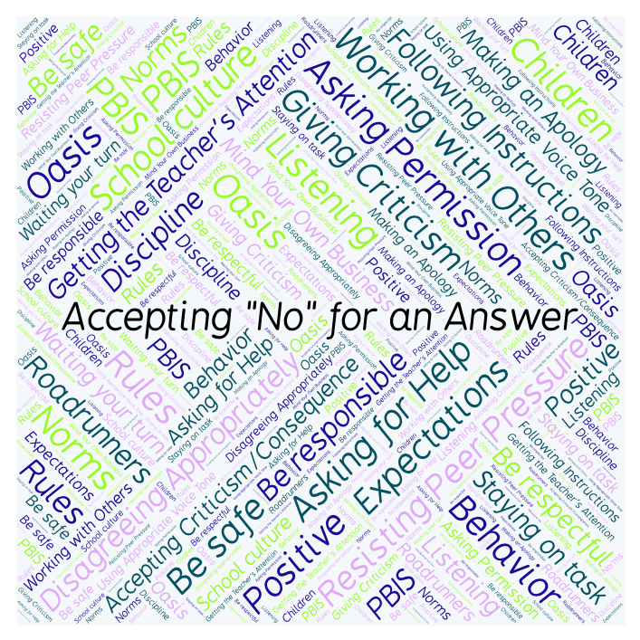
PBIS Social Skills
Day 2

Slide 2
Accepting “No” for an Answer
Remember, this week we are talking about Accepting “No” for an Answer.
Let’s review the four steps

Slide 3
Accepting “No” for an Answer
Step 1: Look at the person.

Slide 4
Accepting “No” for an Answer
Step 2: Say “Okay.”

Slide 5
Accepting “No” for an Answer
Step 3: Stay calm.

Slide 6
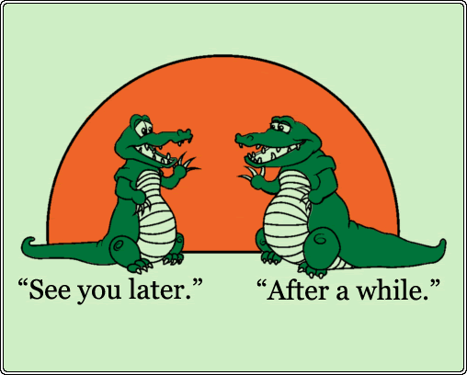
Accepting “No” for an Answer
Step 4: If you disagree, ask later.

Slide 7
Accepting “No” for an Answer
When you are able to Accept “No” for an Answer, you are more likely to get the answer you want next time.
Okay, today we are going to talk more about the first step.
Step 1 is “Look at the person.”

Slide 8
Accepting “No” for an Answer
Why do you think it is important to look at someone when they are saying “no” to you?
Turn to your elbow partner and practice step 1 while you are explaining your answer to this question.

Slide 9
Accepting “No” for an Answer
What do you think would happen if you didn’t look at someone when they were telling you “no”?
Now turn to your elbow partner and demonstrate a non-example of this step while explaining your answer.

Slide 10
Accepting “No” for an Answer
Here’s a video of a girl who doesn’t take “no” for an answer

Slide 11
Accepting “No” for an Answer
Have a discussion with your elbow partner:
In the movie you just watched, how could the girl have done a better job of accepting “no” for an answer?
Which step do you think you need to work on the most? Why?

Slide 12
Accepting “No” for an Answer
Project for the Week
Write in your journal about a time you had to accept “no” for an answer.
Be sure to include:
a description of what happened and how you might have handled it better.
The four steps you learned for Accepting “No” for an Answer.
Consider writing your journal entry on KidBlog.

