Slide 1
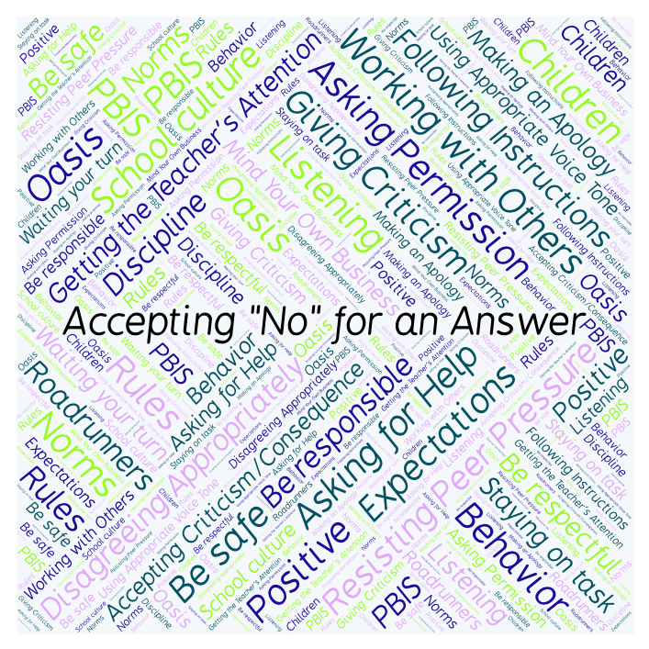
PBIS Social Skills
Day 3

Slide 2
Accepting “No” for an Answer
Remember, this week we are talking about Accepting “No” for an Answer.
Let’s review the four steps.

Slide 3
Accepting “No” for an Answer
Step 1: Look at the person.

Slide 4
Accepting “No” for an Answer
Step 2: Say “Okay.”

Slide 5
Accepting “No” for an Answer
Step 3: Stay calm.

Slide 6
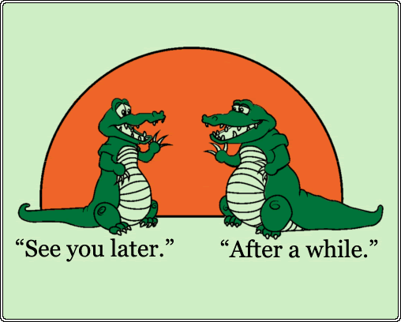
Accepting “No” for an Answer
Step 4: If you disagree, ask later.

Slide 7
Accepting “No” for an Answer
When you are able to Accept “No” for an Answer, you are more likely to get the answer you want next time.
Okay, today we are going to talk more about the second step.
Step 2 is “Say ‘Okay.’”

Slide 8
Accepting “No” for an Answer
Why do you think it is iimportant to say “Okay” when someone says “no” to you.
Who would like to come to the front of the classroom and practice step 2 by acting out a situation where you ask a question and your partner says “no?”

Slide 9
Accepting “No” for an Answer
What do you think would happen if you didn’t say “okay” or acknowledge the person saying “no” in some way?
Who would like to come to the front of the classroom and demonstrate a non-example of this step by acting out a situation where you ask a question and your partner says “no?”

Slide 10
Accepting “No” for an Answer
Work in groups on a laptop to write an Acrostic Poem about accepting “no” for an answer.
Consider using the ReadWriteThink program to compose your poem.
When you are finished, please print the final poem or email it to your teacher.

Slide 11
Accepting “No” for an Answer
Project for the Week
Write in your journal about a time you had to accept “no” for an answer.
Be sure to include:
a description of what happened and how you might have handled it better.
The four steps you learned for Accepting “No” for an Answer.
Consider writing your journal entry on KidBlog.

