Slide 1
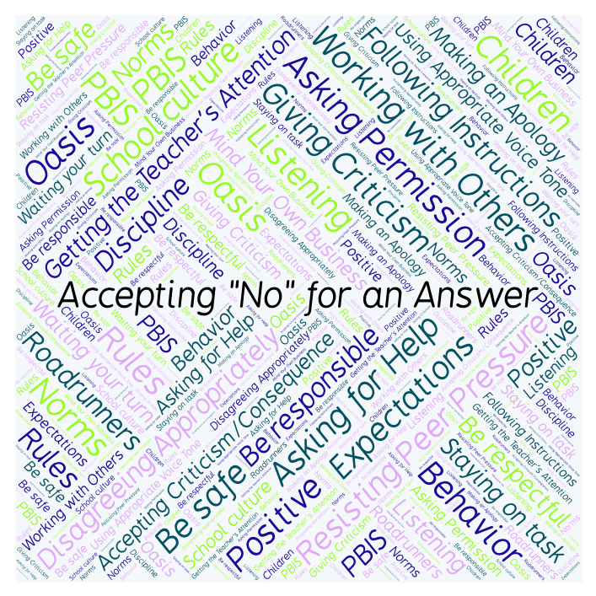
PBIS Social Skills
Day 4

Slide 2
Accepting “No” for an Answer
Remember, this week we are talking about Accepting “No” for an Answer.
Let’s review the four steps.

Slide 3
Accepting “No” for an Answer
Step 1: Look at the person.

Slide 4
Accepting “No” for an Answer
Step 2: Say “Okay.”

Slide 5
Accepting “No” for an Answer
Step 3: Stay calm.

Slide 6
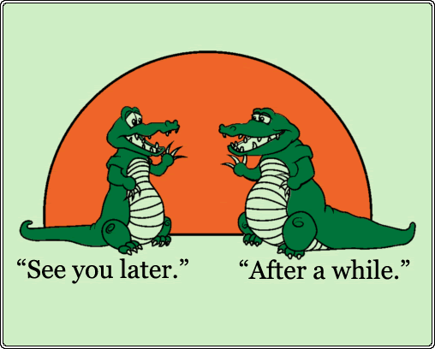
Accepting “No” for an Answer
Step 4: If you disagree, ask later.

Slide 7
Accepting “No” for an Answer
When you are able to Accept No for an Answer, you are more likely to get the answer you want next time.
Okay, today we are going to talk more about the third and fourth steps.
Step 3 is “Stay calm.”

Slide 8
Accepting “No” for an Answer
Why do you think it is important to stay calm when someone says “no” to you?
Turn to your elbow partner and practice step 3 by acting out a situation where you ask a question and your partner says “no.”

Slide 9
Accepting “No” for an Answer
What do you think would happen if you didn’t stay calm when someone said “no” to you?
Turn to your elbow partner and demonstrate a non-example of this step by acting out a situation where you ask a question and your partner says “no.”

Slide 10
Accepting “No” for an Answer
Step 4 is “If you disagree, ask later.”
When do you think would be a good time to ask again?
Turn to your elbow partner and practice step 4 by acting out a situation where someone says “no” to you and you come back later to ask again.

Slide 11
Accepting “No” for an Answer
What do you think would happen if someone says “no” to you and you start arguing with them right away?
Turn to your elbow partner and demonstrate a non-example of this step while acting out the situation above.

Slide 12
Accepting “No” for an Answer
Log in to Edmodo and navigate to the “PBIS Social Skills” group. If you haven’t already joined, the code is w483zg.
Find the “Accepting “No” for an Answer Discussion Prompt” and respond in writing by clicking on the Reply button.

Slide 13
Accepting “No” for an Answer
Project for the Week
Write in your journal about a time you had to accept “no” for an answer.
Be sure to include:
a description of what happened and how you might have handled it better.
The four steps you learned for Accepting “No” for an Answer.
Consider writing your journal entry on KidBlog.

