Slide 1
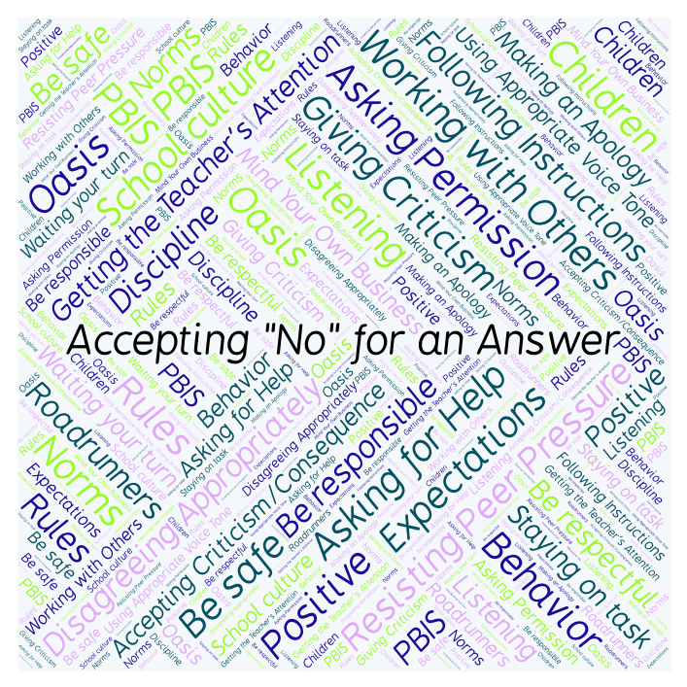
PBIS Social Skills
Day 5

Slide 2
Accepting “No” for an Answer
Remember, this week we are talking about Accepting “No” for an Answer.
Let’s review the four steps.

Slide 3
Accepting “No” for an Answer
Step 1: Look at the person.

Slide 4
Accepting “No” for an Answer
Step 2: Say “Okay.”

Slide 5
Accepting “No” for an Answer
Step 3: Stay calm.

Slide 6
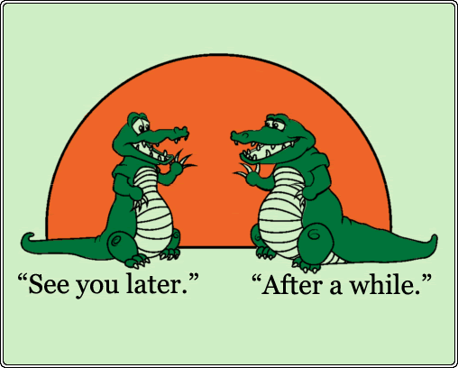
Accepting “No” for an Answer
Step 4: If you disagree, ask later.

Slide 7
Accepting “No” for an Answer
When you are able to Accept “No” for an Answer, you are more likely to get the answer you want next time.
Okay, today we are going to present the Projects we have been working on this week. Who wouldlike to be the first volunteer?

