Slide 1
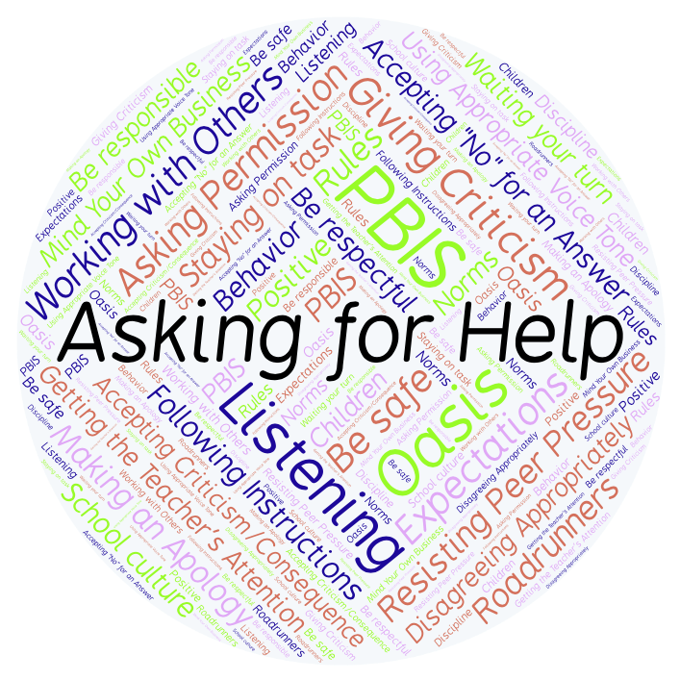
PBIS Social Skills
Day 4

Slide 2
Asking for Help
Remember, this week we are talking about Asking for Help.
Let’s review the four steps.

Slide 3
Asking for Help
Step 1: Look at the person.

Slide 4
Asking for Help
Step 2: Ask the person if they have time to help you.

Slide 5
Asking for Help
Step 3: Clearly explain the kind of help you need.

Slide 6
Asking for Help
Step 4: Thank the person for helping you.

Slide 7
Asking for Help
When you are able to ask for help, you have a better chance of getting your question answered and doing better on your assignment.
Okay, today we are going to talk more about the third and fourth steps.
Step 3 is “Clearly explain the kind of help you need.”

Slide 8
Asking for Help
Why do you think it is important to give as much detail about the type of help you need as possible?
Turn to your elbow partner and practice step 3 by asking for help in understanding your math homework.

Slide 9
Asking for Help
What do you think could happen if you didn’t give enough detail about the type of help that you need?
Turn to your elbow partner and demonstrate a non-example of this step while asking for help in understanding your math homework.

Slide 10
Asking for Help
Step 4 is “Thank the person for helping you.”
Why should you say “thank you” when someone has helped you?
Turn to your elbow partner and practice step 4 by continuing your conversation about the math homework.

Slide 11
Asking for Help
How do you think someone would react if you didn’t say “thank you” after they helped you with something?
Turn to your elbow partner and demonstrate a non-example of this step by continuing your conversation about the math homework.

Slide 12
Asking for Help
Log in to Edmodo and navigate to the “PBIS Social Skills” group. If you haven’t already joined, the code is w483zg.
Find the “Asking for Help Discussion Prompt” and respond in writing by clicking on the Reply button.

Slide 13
Asking for Help
Project for the Week
Work with your table group to create a brochure about Asking for Help. Consider creating it in Word or Pages using a brochure template.
Be sure to include:
Descriptions of the four steps you learned for Resisting Peer Pressure and why they are important.
An illustration related to each step.
A personal connection related to each step.
Present the brochure to your class.

