Slide 1
PBIS Social Skills
Day 3

Slide 2
Asking Permission
Remember, this week we are talking about Asking Permission.
Let’s review the four steps.

Slide 3
Asking Permission
Step 1: Look at the person.

Slide 4
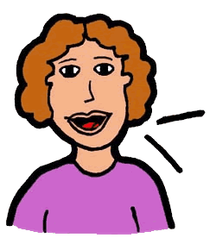
Asking Permission
Step 2: Use a calm and pleasant voice.

Slide 5
Asking Permission
Step 3: Say, “May I…”
May I…?

Slide 6
Asking Permission
Step 4: Accept the answer calmly.

Slide 7
Asking Permission
When you Ask Permission in this way, people are more likely to give you the answer you want.
Okay, today we are going to talk more about the second step.
Step 2 is “Use a calm and pleasant voice.”

Slide 8
Asking Permission
Why do you think it is important to use a calm and pleasant voice when you are asking permission for something?
Who would like to come to the front of the classroom and practice step 2 while you are explaining your answer to this question?

Slide 9
Asking Permission
What do you think would happen if you didn’t use a calm and pleasant voice when you were asking permission for something?
Who would like to come to the front of the classroom and demonstrate a non-example of this step while explaining your answer?

Slide 10
Asking Permission
Work in groups on a laptop to write a Diamante Poem about asking permission.
Consider using the ReadWriteThink program to compose your poem.
When you are finished, please print the final poem or email it to your teacher.

Slide 11
Asking Permission
Project for the Week
Work with your table group to write a fictional narrative about a character who must ask permission for something. Consider creating your narrative using the Story Creator app.
Be sure to include:
a story with a beginning, middle, and end, and at least two characters who interact.
The four steps you learned for Asking Permission.
Read the story to your class.

