Slide 1
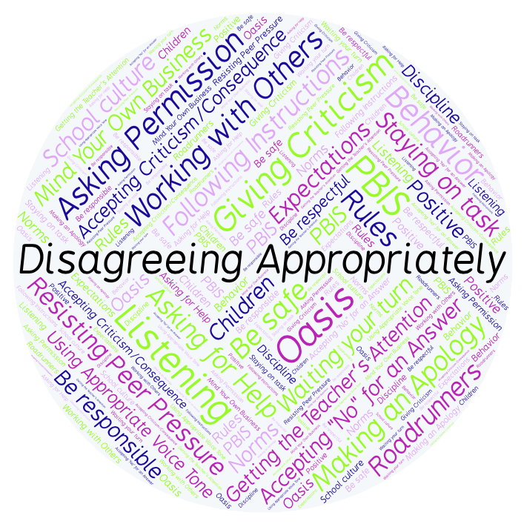
PBIS Social Skills
Day 1

Slide 2
Disagreeing Appropriately
What is something you and your best friend disagree about? How do you handle that?
To respond to the prompt, scan the QR code to the right from the Padlet app or click here.
Once you have opened the Padlet, click on the plus sign ( + ) in the bottom right hand corner and enter your response.
Look around the Padlet to see what others have said.

Slide 3
Disagreeing Appropriately
This week we are going to talk about Disagreeing Appropriately.
Let’s learn the six steps all students must do when asked to disagree appropriately.

Slide 4
Disagreeing Appropriately
Step 1: Look at the person.

Slide 5
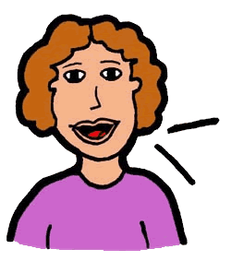
Disagreeing Appropriately
Step 2: Use a pleasant voice.

Slide 6
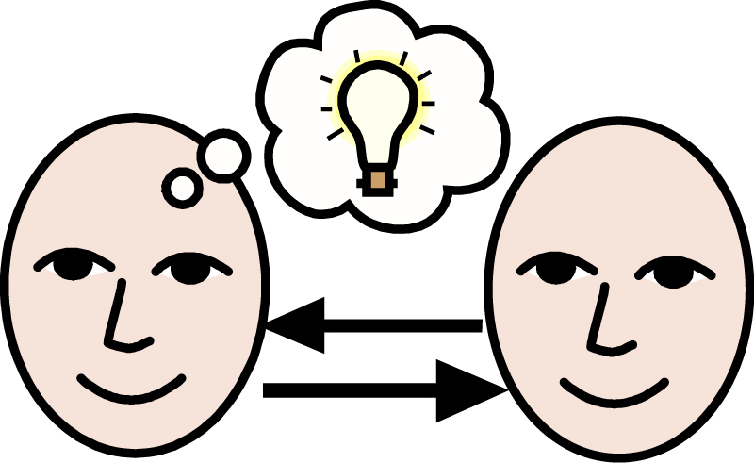
Disagreeing Appropriately
Step 3: Say, “I understand how you feel.”

Slide 7
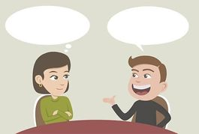
Disagreeing Appropriately
Step 4: Tell why you feel differently.

Slide 8
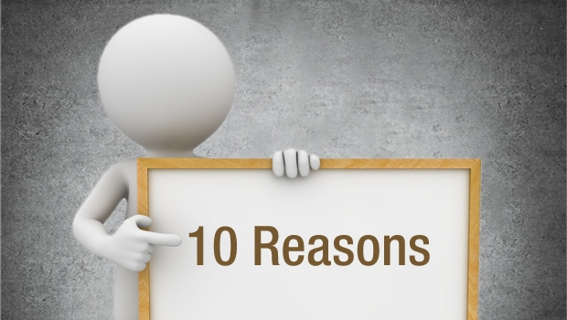
Disagreeing Appropriately
Step 5: Give a reason.

Slide 9
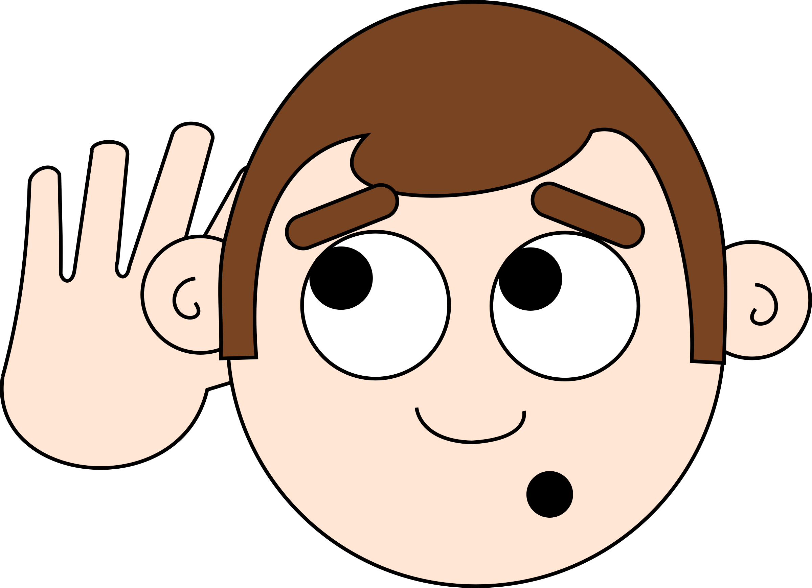
Disagreeing Appropriately
Step 6: Listen to the other person.

Slide 10
Disagreeing Appropriately
We will be practicing these steps all week.
When you are able to disagree appropriately, you have a better chance of solving your problems peacefully and keeping your friends.

Slide 11
Disagreeing Appropriately
Project for the Week
Write a letter to a close friend or relative and describe what you have learned about Disagreeing Appropriately. Consider using email to compose and send your letter.
Be sure to include:
a heading, a greeting, a body, a closing, and a signature.
The six steps you learned for Disagreeing Appropriately.
Share your letter with your table group.

