Slide 1
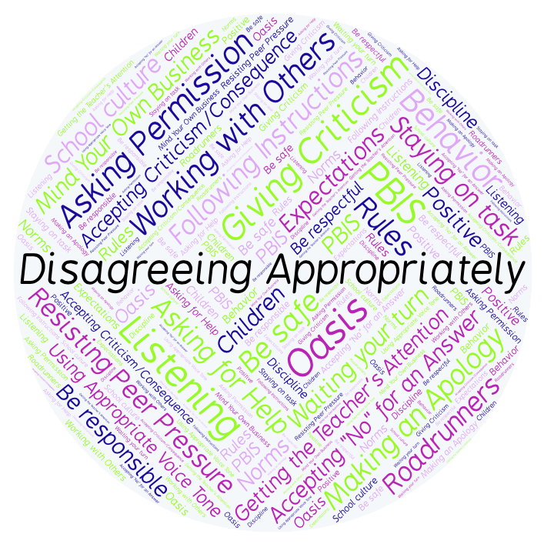
PBIS Social Skills
Day 2

Slide 2
Disagreeing Appropriately
Remember, this week we are talking about Disagreeing Appropriately.
Let’s review the six steps.

Slide 3
Disagreeing Appropriately
Step 1: Look at the person.

Slide 4
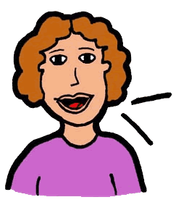
Disagreeing Appropriately
Step 2: Use a pleasant voice.

Slide 5
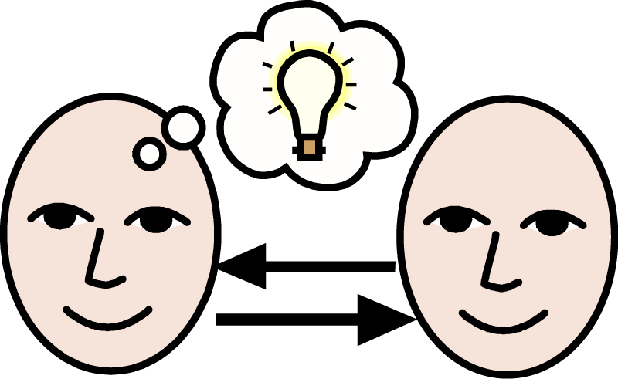
Disagreeing Appropriately
Step 3: Say, “I understand how you feel.”

Slide 6
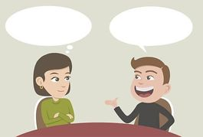
Disagreeing Appropriately
Step 4: Tell why you feel differently.

Slide 7
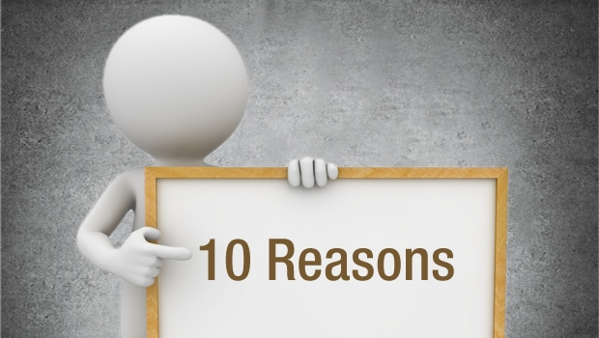
Disagreeing Appropriately
Step 5: Give a reason.

Slide 8
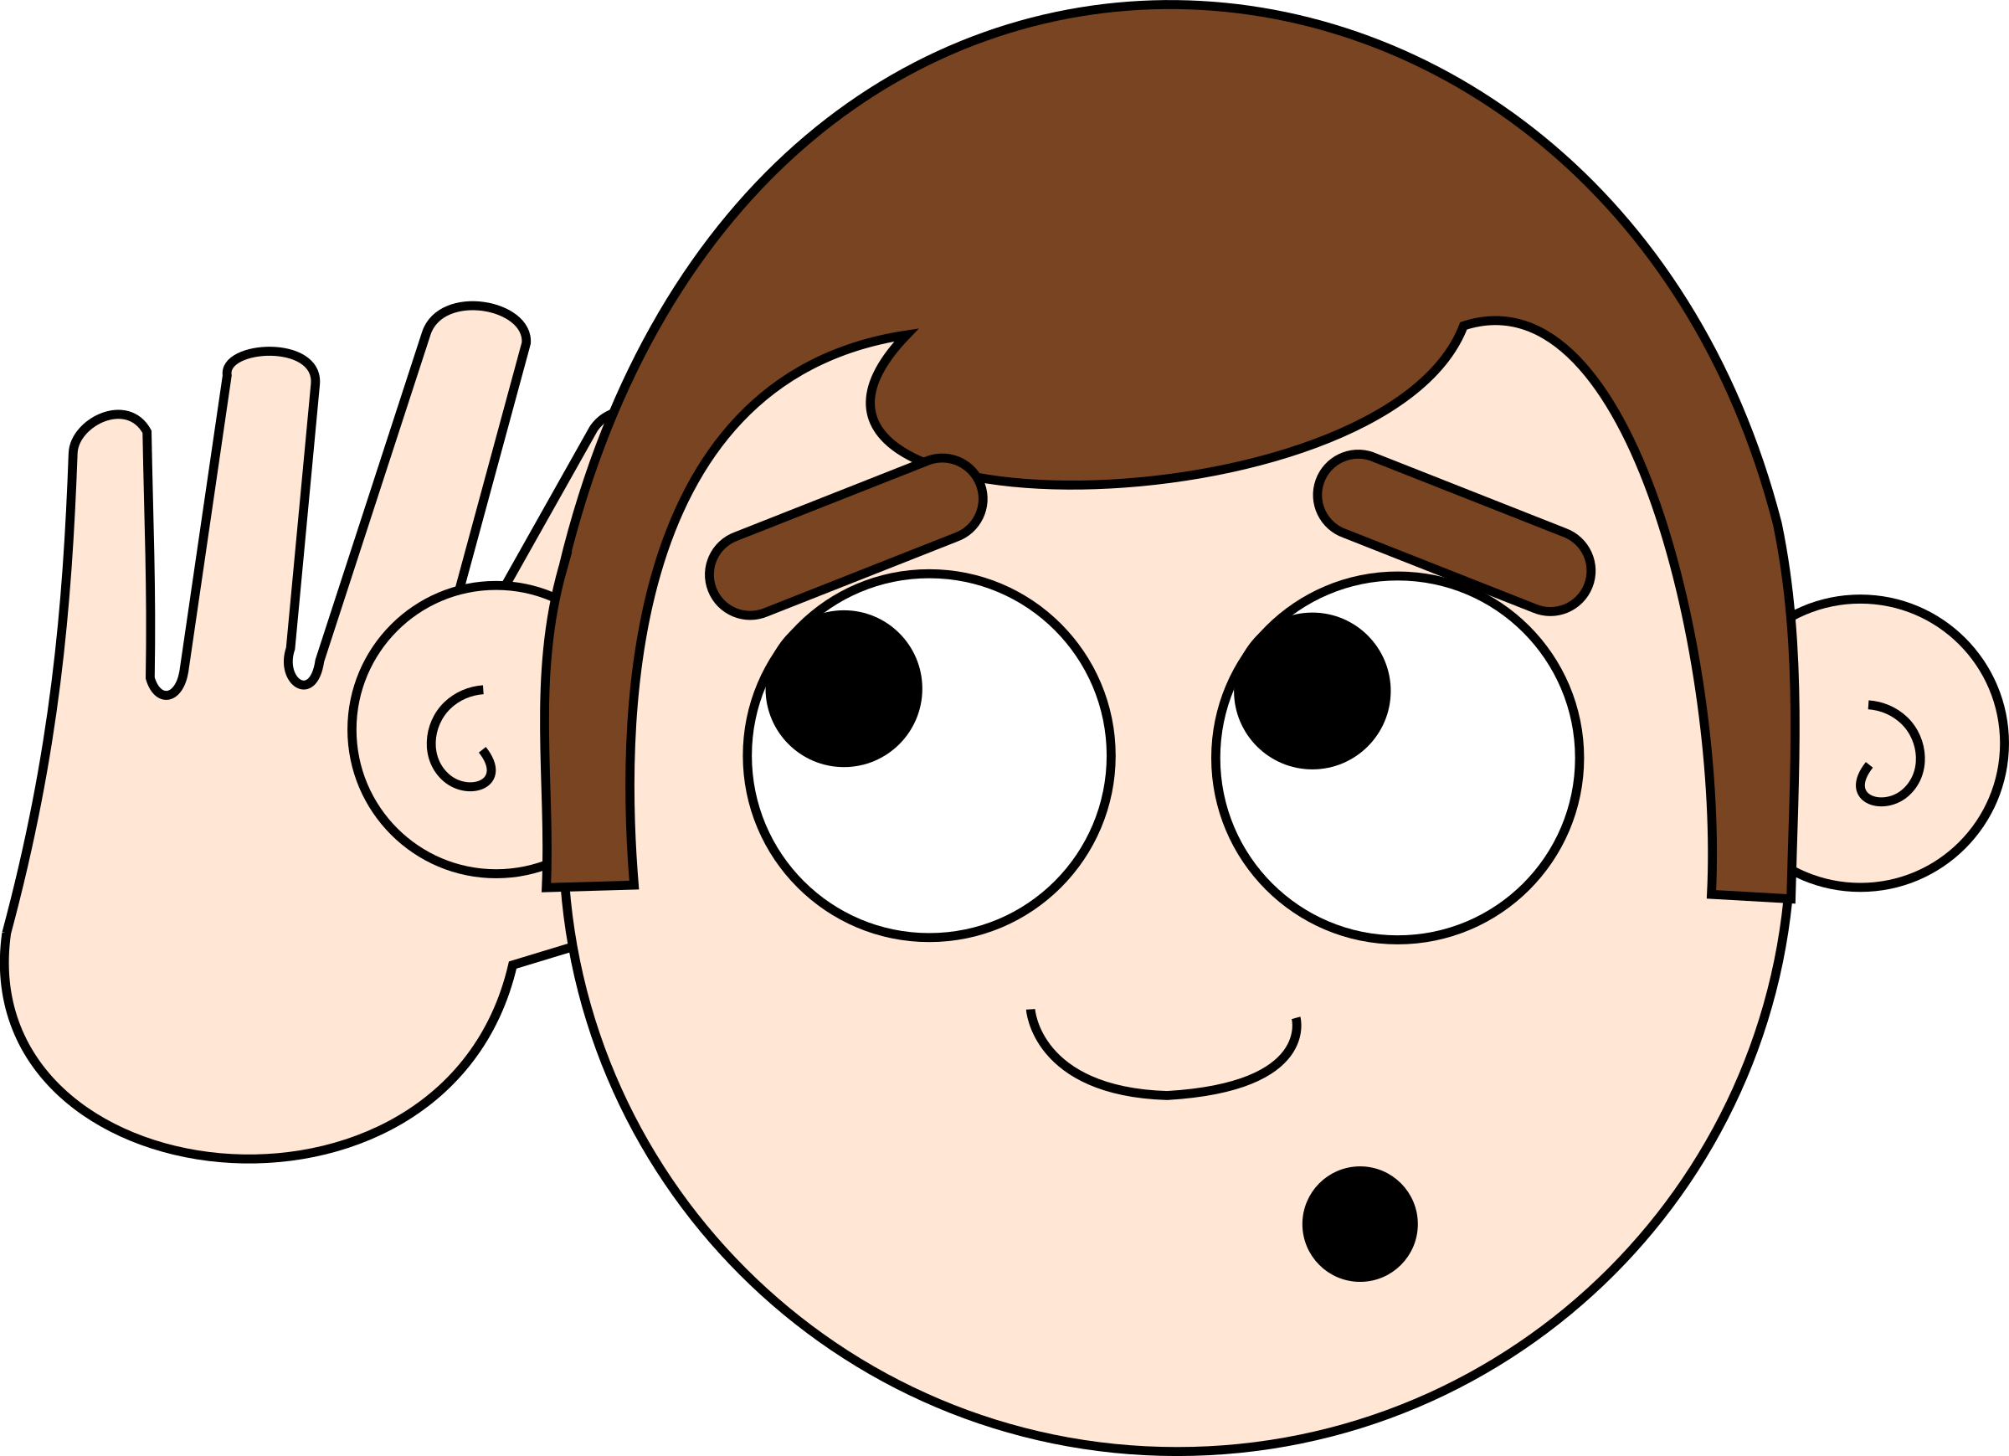
Disagreeing Appropriately
Step 6: Listen to the other person.

Slide 9
Disagreeing Appropriately
When you are able to Disagree Appropriately, you have a better chance of solving your problems peacefully and keeping your friends.
Okay, today we are going to talk more about the first and second steps.
Step 1 us “Look at the Person.”

Slide 10
Disagreeing Appropriately
Why do you think it is important to look at someone when the two of you are disagreeing about something?
Turn to your elbow partner and practice step 1 while you are explaining your answer to this question.

Slide 11
Disagreeing Appropriately
What do you think would happen if you didn’t look at your partner when communicating?
Turn to your elbow partner and demonstrate a non-example of this step while explaining your answer.

Slide 12
Disagreeing Appropriately
Step 2 is “Use a pleasant voice.”
Why do you think it is important to use a pleasant voice when disagreeing about something?
Turn to your elbow partner and practice step 2 while you are explaining your answer to this question.

Slide 13
Disagreeing Appropriately
What could happen if you didn’t use a pleasant voice when disagreeing about something?
Turn to your elbow partner and demonstrate a non-example of this step while explaining your answer.

Slide 14
Disagreeing Appropriately
Let’s see what Kid President has to say about disagreeing:

Slide 15
Disagreeing Appropriately
Have a discussion with your elbow partner:
In the video you just watched, Kid President said “Nobody wins when all you want to do is win.” What does he mean by that? Is winning an argument important? Why or why not?
Which step do you think you need to work on the most? Why?

Slide 16
Disagreeing Appropriately
Project for the Week
Write a letter to a close friend or relative and describe what you have learned about Disagreeing Appropriately. Consider using email to compose and send your letter.
Be sure to include:
a heading, a greeting, a body, a closing, and a signature.
The six steps you learned for Disagreeing Appropriately.
Share your letter with your table group.

