Slide 1
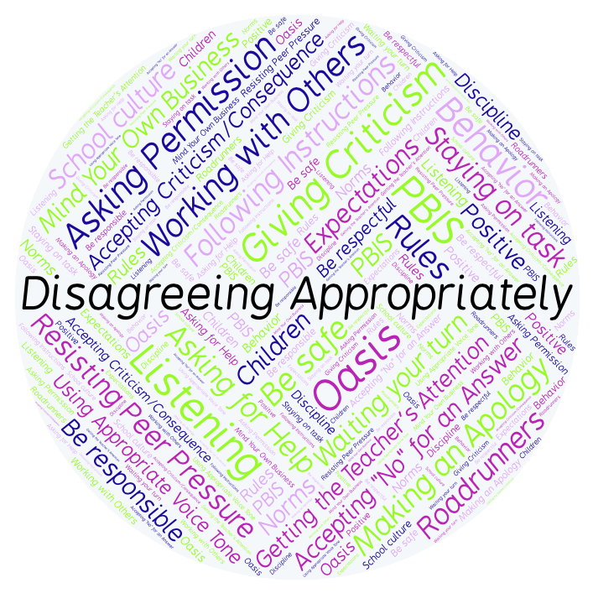
PBIS Social Skills
Day 3

Slide 2
Disagreeing Appropriately
Remember, this week we are talking about Disagreeing Appropriately.
Let’s review the six steps.

Slide 3
Disagreeing Appropriately
Step 1: Look at the person.

Slide 4
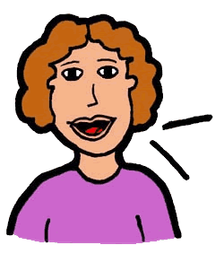
Disagreeing Appropriately
Step 2: Use a pleasant voice.

Slide 5
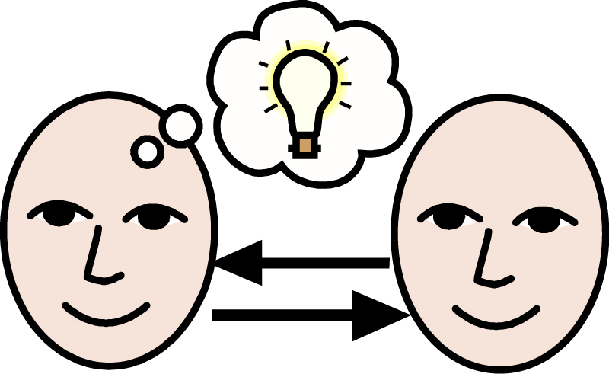
Disagreeing Appropriately
Step 3: Say, “I understand how you feel.”

Slide 6
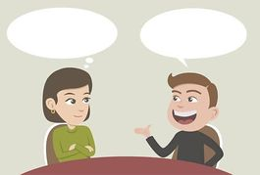
Disagreeing Appropriately
Step 4: Tell why you feel differently.

Slide 7
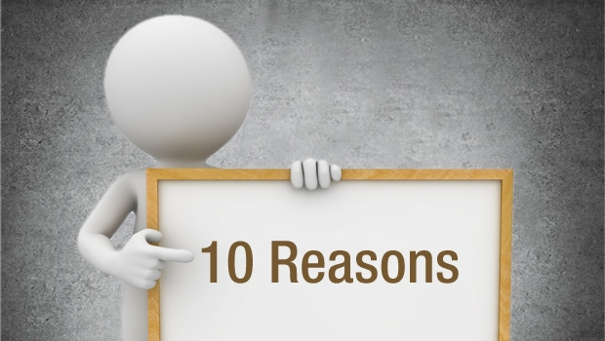
Disagreeing Appropriately
Step 5: Give a reason.

Slide 8
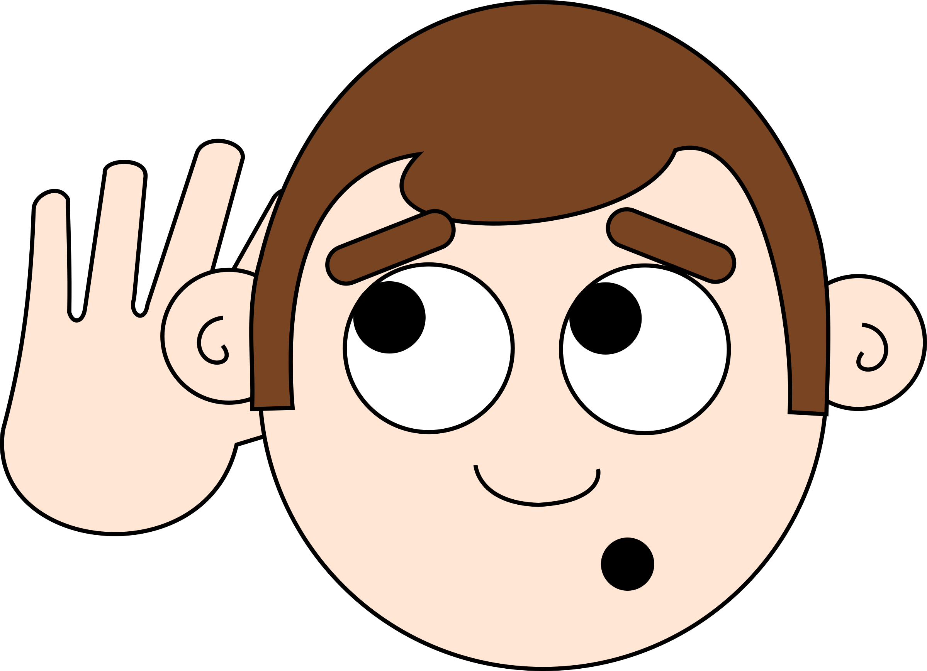
Disagreeing Appropriately
Step 6: Listen to the other person.

Slide 9
Disagreeing Appropriately
When you are able to Disagree Appropriately, you have a better chance of solving your problems peacefully and keeping your friends.
Okay, today we are going to talk more about the third and fourth steps.
Step 3 us “Say, ‘I understand how you feel’.”

Slide 10
Disagreeing Appropriately
Why do you think it is important to understand the other person’s point of view when you are disagreeing?
Who would like to come to the front of the classroom and demonstrate step 3 by disagreeing about your favorite food?

Slide 11
Disagreeing Appropriately
What do you think would happen if you didn’t try to understand the other person’s point of view when disagreeing with them?
Who would like to come to the front of the classroom and demonstrate a non-example of this step while disagreeing about your favorite sport?

Slide 12
Disagreeing Appropriately
Step 4 is “Tell why you feel differently.”
Why do you think it is important to tell the person you are having a disagreement with, why you feel differently?
Who would like to come to the front of the classroom and demonstrate step 4 with a partner?

Slide 13
Disagreeing Appropriately
What do you think would happen if you refused to give information to the other person about why you feel differently?
Who would like to come to the front of the classroom and demonstrate a non-example of this step?

Slide 14
Disagreeing Appropriately
Work in groups on a laptop to write an Acrostic Poem about disagreeing appropriately.
Consider using the ReadWriteThink program to compose your poem.
When you are finished, please print the final poem or email it ot your teacher.

Slide 15
Disagreeing Appropriately
Project for the Week
Write a letter to a close friend or relative and describe what you have learned about Disagreeing Appropriately. Consider using email to compose and send your letter.
Be sure to include:
a heading, a greeting, a body, a closing, and a signature.
The six steps you learned for Disagreeing Appropriately.
Share your letter with your table group.

