Slide 1
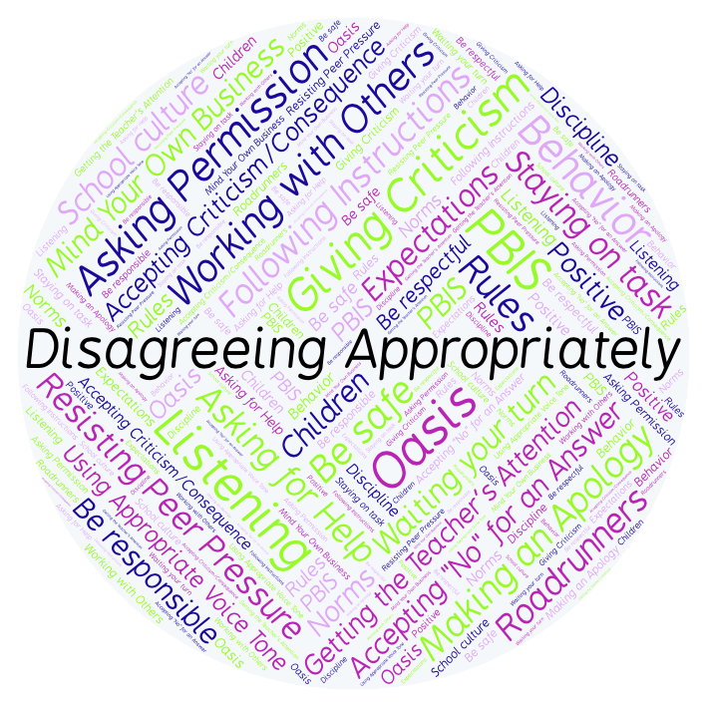
PBIS Social Skills
Day 4

Slide 2
Disagreeing Appropriately
Remember, this week we are talking about Disagreeing Appropriately.
Let’s review the six steps.

Slide 3
Disagreeing Appropriately
Step 1: Look at the person.

Slide 4
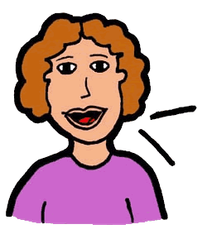
Disagreeing Appropriately
Step 2: Use a pleasant voice.

Slide 5
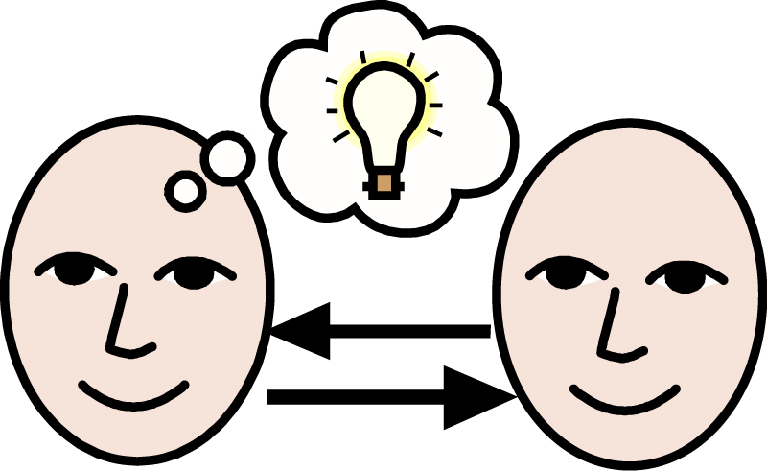
Disagreeing Appropriately
Step 3: Say, “I understand how you feel.”

Slide 6
Disagreeing Appropriately
Step 4: Tell why you feel differently.

Slide 7
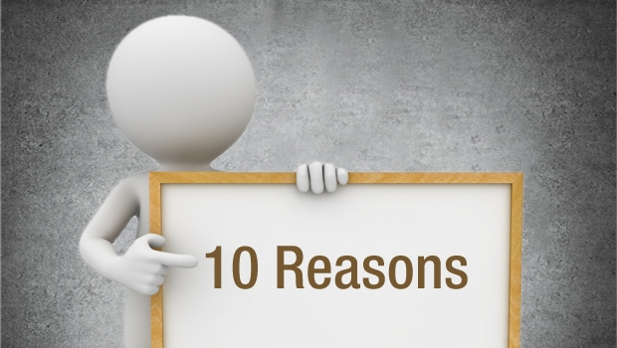
Disagreeing Appropriately
Step 5: Give a reason.

Slide 8
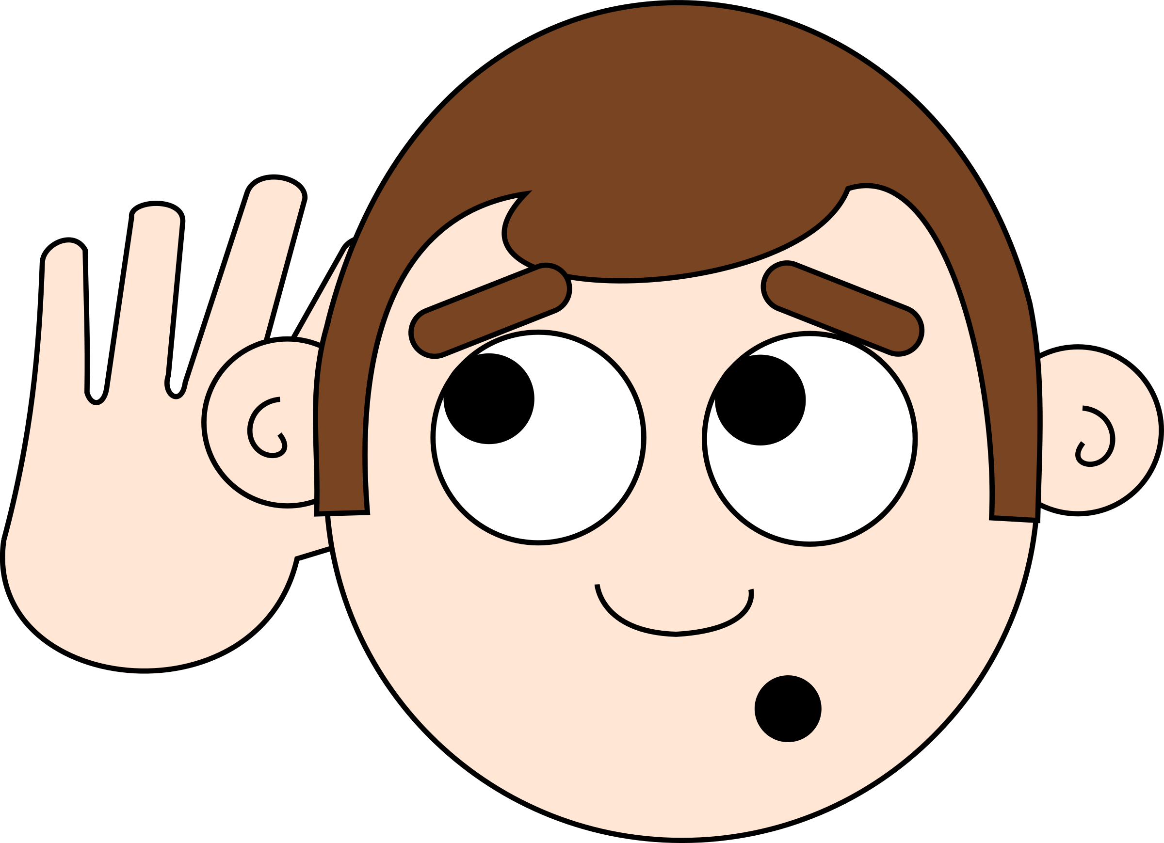
Disagreeing Appropriately
Step 6: Listen to the other person.

Slide 9
Disagreeing Appropriately
When you are able to Disagree Appropriately, you have a better chance of solving your problems peacefully and keeping your friends.
Okay, today we are going to talk more about the fifth and sixth steps.
Step 5 is “Give a reason.”

Slide 10
Disagreeing Appropriately
Why do you think it is important to support your position with valid reasons when you are disagreeing with someone?
Turn to your elbow partner and practice step 5 by giving reasons for your favorite ice cream flavor.

Slide 11
Disagreeing Appropriately
What do you think would happen if you didn’t support your position by giving valid reasons?
Turn to your elbow partner and demonstrate a non-example of this step while disagreeing about your favorite subject in school.

Slide 12
Disagreeing Appropriately
Step 6 is “Listen to the other person.”
Why is giving the other person a chance to speak and really listening to their point of view important?
Turn to your elbow partner and practice step 6 by continuing your disagreement about ice cream flavors.

Slide 13
Disagreeing Appropriately
What do you think would happen if you did not listen to the other person’s point of view?
Turn to your elbow partner and demonstrate a non-example of this step while continuing your disagreement about your favorite subject in school.

Slide 14
Disagreeing Appropriately
Log in to Edmodo and navigate to the “PBIS Social Skills” group. If you haven’t already joined, the code is w483zg.
Find the “Disagreeing Appropriately Discussion Prompt” and respond in writing by clicking on the Reply button.

Slide 15
Disagreeing Appropriately
Project for the Week
Write a letter to a close friend or relative and describe what you have learned about Disagreeing Appropriately. Consider using email to compose and send your letter.
Be sure to include:
a heading, a greeting, a body, a closing, and a signature.
The six steps you learned for Disagreeing Appropriately.
Share your letter with your table group.

