Slide 1
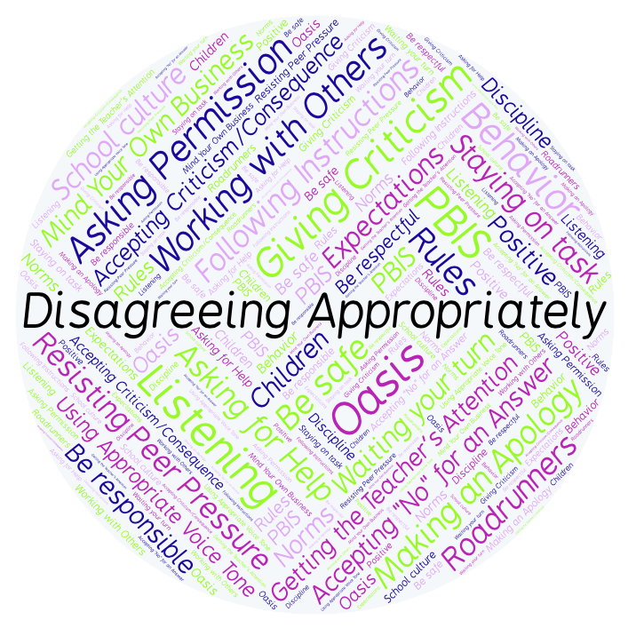
PBIS Social Skills
Day 5

Slide 2
Disagreeing Appropriately
Remember, this week we are talking about Disagreeing Appropriately.
Let’s review the six steps.

Slide 3
Disagreeing Appropriately
Step 1: Look at the person.

Slide 4
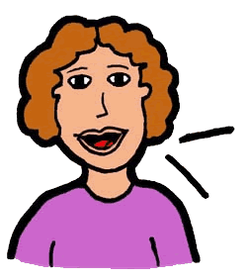
Disagreeing Appropriately
Step 2: Use a pleasant voice.

Slide 5
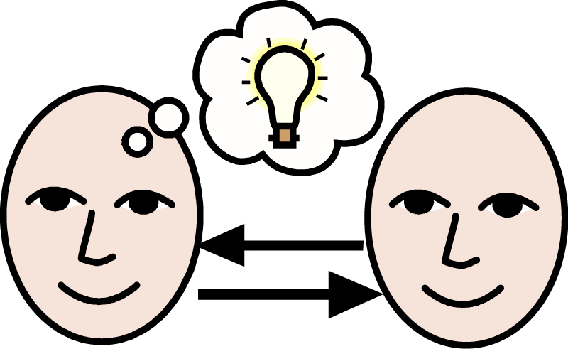
Disagreeing Appropriately
Step 3: Say, “I understand how you feel.”

Slide 6
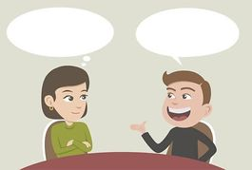
Disagreeing Appropriately
Step 4: Tell why you feel differently.

Slide 7
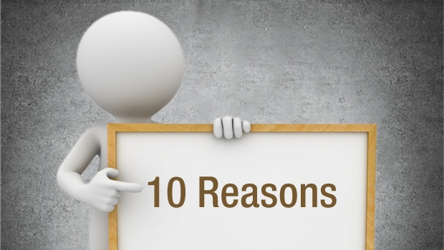
Disagreeing Appropriately
Step 5: Give a reason.

Slide 8
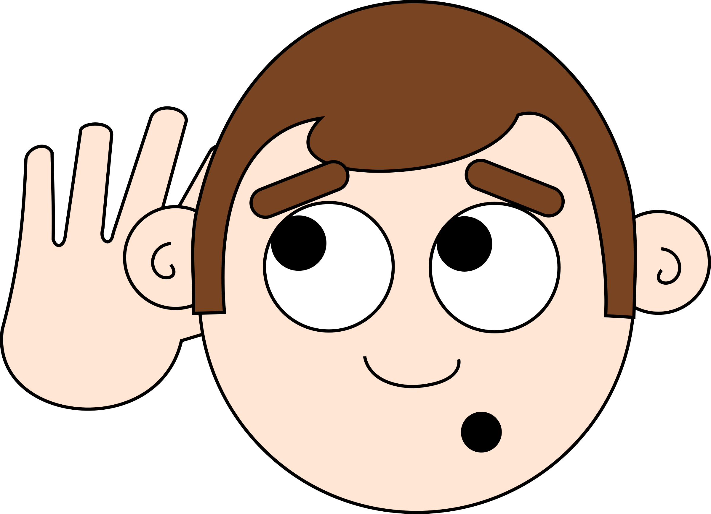
Disagreeing Appropriately
Step 6: Listen to the other person.

Slide 9
Disagreeing Appropriately
When you are able to Disagree Appropriately, you have a better chance of solving your problems peacefully and keeping your friends.
Okay, today we are going to present the Projects we have been working on this week. Who would like to be the first volunteer?

