Slide 1
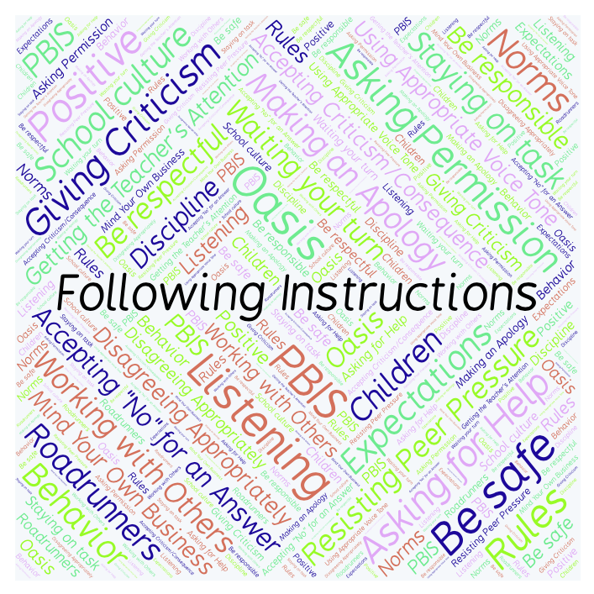
PBIS Social Skills
Day 1

Slide 2
Following Instructions
Who might give you instructions at school? Why is it important to follow them?
To respond to the prompt, scan the QR code to the right from the Padlet app or click here.
Once you have opened the Padlet, click on the plus sign ( + ) in the bottom right hand corner and enter your response.
Look around the Padlet to see what others have said.

Slide 3
Following Instructions
This week we are going to talk about Following Instructions.
Let’s learn the four steps all students must do when asked to follow instructions.

Slide 4
Following Instructions
Step 1: Look at the person.

Slide 5
Following Instructions
Step 2: Say, “Okay.”

Slide 6
Following Instructions
Step 3: Do what you have been asked right away.

Slide 7
Following Instructions
Step 4: Check back.

Slide 8
Following Instructions
We will be practicing these steps all week.
When you follow instructions right away, you have a better chance of helping our class run smoothly so that everyone can learn.

Slide 9
Following Instructions
Project for the Week
Work with your table group to write a song or a rap about how to Follow Instructions.
Be sure to include:
Both lyrics (words) and music. You may use the tune of a familiar song if you wish.
The four steps you learned for Following Instructions.
Consider recording and editing your song using Garage Band. Perform your song for the class.

