Slide 1
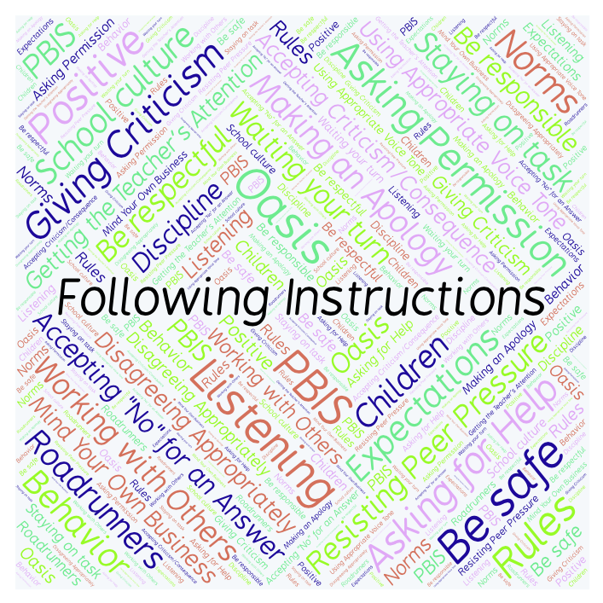
PBIS Social Skills
Day 2

Slide 2
Following Instructions
Remember, this week we are talking about Following Instructions.
Let’s review the four steps.

Slide 3
Following Instructions
Step 1: Look at the person.

Slide 4
Following Instructions
Step 2: Say, “Okay.”

Slide 5
Following Instructions
Step 3: Do what you have been asked right away.

Slide 6
Following Instructions
Step 4: Check back.

Slide 7
Following Instructions
When you follow instructions right away, you have a better chance of helping our class run smoothly so that everyone can learn.
Okay, today we are going to talk more about the first step.
Step 1 is “Look at the person.”

Slide 8
Following Instructions
Why do you think it is important to look at someone when they are giving you instructions?
Turn to your elbow partner and practice step 1 while you are explaining your answer to this question.

Slide 9
Following Instructions
Now turn to your elbow partner and demonstrate a non-example of this step while explaining your answer.
What could happen if you didn’t look at someone while they were giving you instructions?

Slide 10
Following Instructions
Let’s watch Cookie Monster learn about the importance of
following instructions.

Slide 11
Following Instructions
Have a discussion with your elbow partner:
In the video you just watched, how could Cookie Monster have used the four steps to Following Instructions to be more successful at completing his tasks?
Which step do you think you need to work on the most? Why?

Slide 12
Following Instructions
Project for the Week
Work with your table group to write a song or rap about Following Instructions.
Be sure to include all the steps we’ve learned for Following Instructions.
You may write your song or rap on paper or in Word or Pages. Consider recording it in Garage Band
Perform your song or rap live or by playing your Garage Band track.

