Slide 1
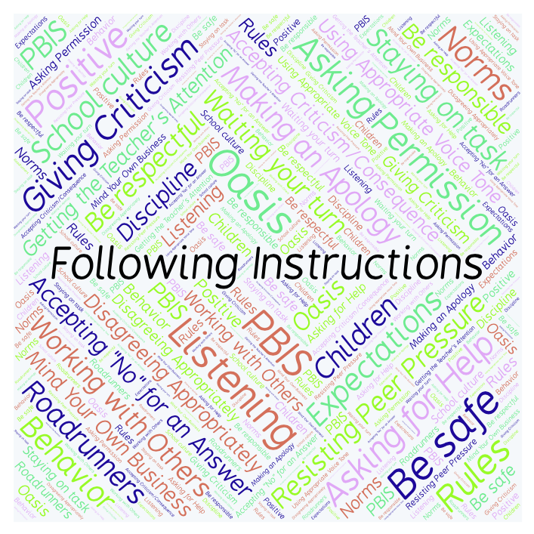
PBIS Social Skills
Day 3

Slide 2
Following Instructions
Remember, this week we are talking about Following Instructions.
Let’s review the four steps.

Slide 3
Following Instructions
Step 1: Look at the person.

Slide 4
Following Instructions
Step 2: Say, “Okay.”

Slide 5
Following Instructions
Step 3: Do what you have been asked right away.

Slide 6
Following Instructions
Step 4: Check back.

Slide 7
Following Instructions
When you follow instructions right away, you have a better chance of helping our class run smoothly so that everyone can learn.
Okay, today we are going to talk more about the second step.
Step 2 is “Say, ‘Okay’.”

Slide 8
Following Instructions
Why do you think it is important to say “Okay” when a staff member give you instructions?
Who would like to come to the front of the classroom and practice step 2 by acknowledging my instructions?

Slide 9
Following Instructions
What do you think would happen if you didn’t say “Okay” when a staff member gave you instructions?
Who would like to come to the front of the classroom and demonstrate a non-example of this step when I give you an instruction?

Slide 10
Following Instructions
Work in groups on a laptop to write a Haiku poem about following instructions.
Consider using the ReadWriteThink program to compose your poem.
When you are finished, please print the final poem or email it to your teacher.

Slide 11
Following Instructions
Project for the Week
Work with your table group to write a song or rap about Following Instructions.
Be sure to include all the steps we’ve learned for Following Instructions.
You may write your song or rap on paper or in Word or Pages. Consider recording it in Garage Band
Perform your song or rap live or by playing your Garage Band track.

