Slide 1
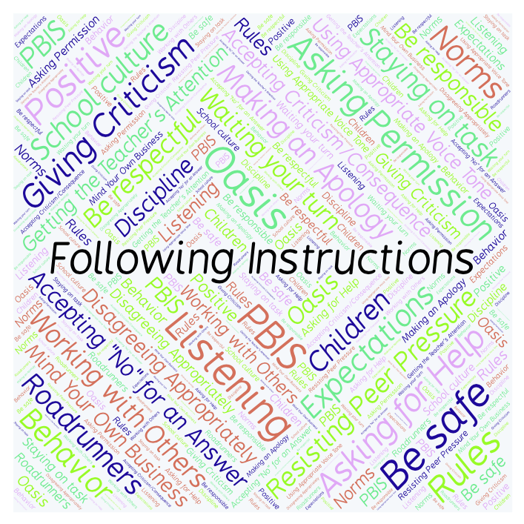
PBIS Social Skills
Day 4

Slide 2
Following Instructions
Remember, this week we are talking about Following Instructions.
Let’s review the four steps.

Slide 3
Following Instructions
Step 1: Look at the person.

Slide 4
Following Instructions
Step 2: Say, “Okay.”

Slide 5
Following Instructions
Step 3: Do what you have been asked right away.

Slide 6
Following Instructions
Step 4: Check back.

Slide 7
Following Instructions
When you follow instructions right away, you have a better chance of helping our class run smoothly so that everyone can learn.
Okay, today we are going to talk more about the third and fourth steps.
Step 3 is “Do what you have been asked right away.”

Slide 8
Following Instructions
Why do you think it is important to do what you have been asked right away?
Turn to your elbow partner and practice step 3 by following each other’s instructions right away.

Slide 9
Following Instructions
What do you think would happen if you didn’t do what you were asked right away?
Turn to your elbow partner and demonstrate a non-example of this step while giving each other instructions.

Slide 10
Following Instructions
Step 4 is “Check back.”
Why is it important to check back with the person who gave you instructions?
Turn to your elbow partner and practice step 4 by checking back after following instructions.

Slide 11
Following Instructions
What do you think could happen if you didn’t check back after following instructions?
Turn to your elbow partner and demonstrate a non-example of this step by not checking back after following instructions.

Slide 12
Following Instructions
Log in to Edmodo and navigate to the “PBIS Social Skills” group. If you haven’t already joined, the code is w483zg.
Find the “Following Instructions Discussion Prompt” and respond in writing by clicking on the Reply button.

Slide 13
Following Instructions
Project for the Week
Work with your table group to write a song or rap about Following Instructions.
Be sure to include all the steps we’ve learned for Following Instructions.
You may write your song or rap on paper or in Word or Pages. Consider recording it in Garage Band
Perform your song or rap live or by playing your Garage Band track.

