Slide 1
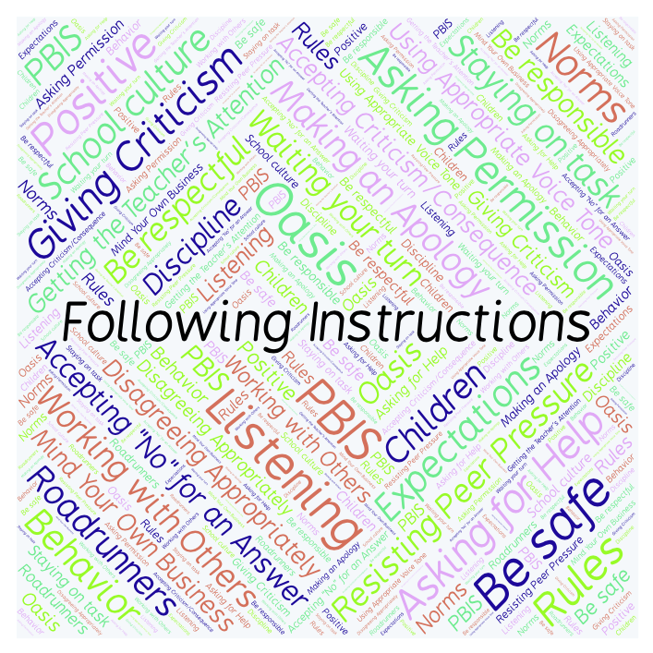
PBIS Social Skills
Day 5

Slide 2
Following Instructions
Remember, this week we are talking about Following Instructions.
Let’s review the four steps.

Slide 3
Following Instructions
Step 1: Look at the person.

Slide 4
Following Instructions
Step 2: Say, “Okay.”

Slide 5
Following Instructions
Step 3: Do what you have been asked right away.

Slide 6
Following Instructions
Step 4: Check back.

Slide 7
Following Instructions
When you follow instructions right away, you have a better chance of helping our class run smoothly so that everyone can learn.
Okay, today we are going to present the Projects we have been working on this week. Who would like to be the first volunteer?

