Slide 1
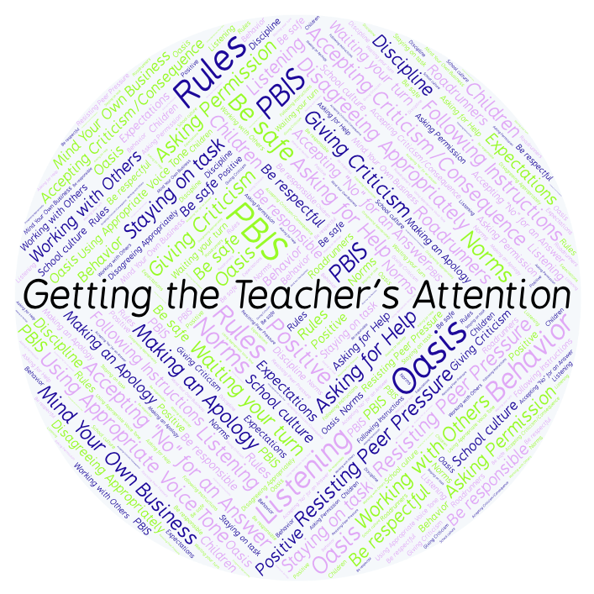
PBIS Social Skills
Day 1

Slide 2
Getting the Teacher’s Attention
What is the craziest thing you have ever done to get someone’s attention?
To respond to the prompt, scan the QR code to the right from the Padlet app or click here.
Once you have opened the Padlet, click on the plus sign ( + ) in the bottom right hand corner and enter your response.
Look around the Padlet to see what others have said.

Slide 3
Getting the Teacher’s Attention
This week we are going to talk about the steps for getting your teacher’s attention.
Let’s review the four steps all students must do when they want to get their teacher’s attention.

Slide 4
Getting the Teacher’s Attention
Step 1: Look at the teacher.

Slide 5
Getting the Teacher’s Attention
Step 2: Raise your hand and stay calm.

Slide 6
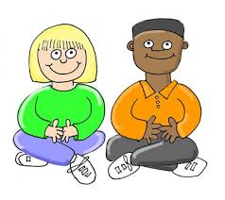
Getting the Teacher’s Attention
Step 3: Wait until the teachers says your name.

Slide 7
Getting the Teacher’s Attention
Step 4: Ask your question or make your statement.

Slide 8
Getting the Teacher’s Attention
We will be practicing these steps all week.
When you use the steps to Getting the Teacher’s Attention appropriately, you have a better chance to get your question answered quickly.

Slide 9
Getting the Teacher’s Attention
Project for the Week
Work with your table group to write a “recipe” for getting your teacher’s attention.
You may create your recipe by hand, or consider using one of the templates here. Look for one that says Recipe Card or Recipe Page.
Be sure to include a list of “ingredients” and instructions for getting your teacher’s attention.
Share your “recipe” with the rest of your class.

