Slide 1
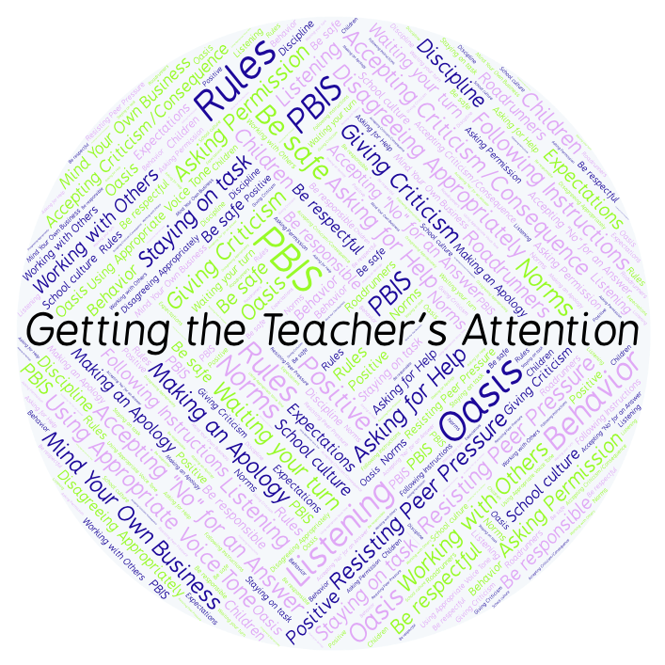
PBIS Social Skills
Day 2

Slide 2
Getting the Teacher’s Attention
Remember, this week we are talking about Getting the Teacher’s Attention.
Let’s review the four steps.

Slide 3
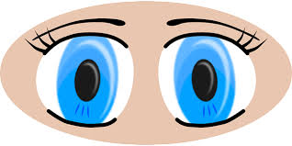
Getting the Teacher’s Attention
Step 1: Look at the teacher.

Slide 4
Getting the Teacher’s Attention
Step 2: Raise your hand and stay calm.

Slide 5
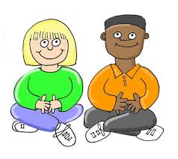
Getting the Teacher’s Attention
Step 3: Wait until the teacher says your name.

Slide 6
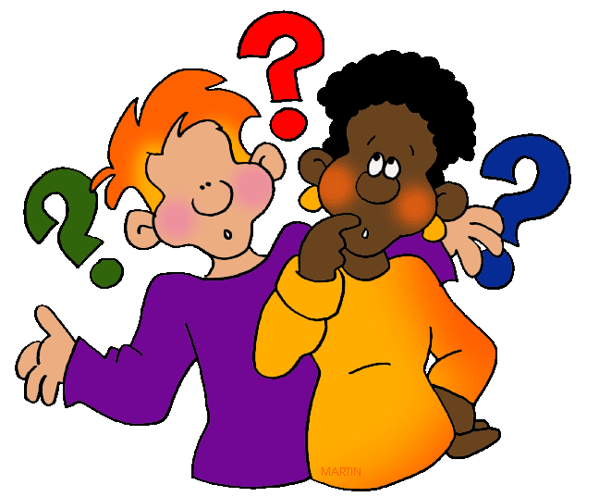
Getting the Teacher’s Attention
Step 4: Ask your question or make your statement.

Slide 7
Getting the Teacher’s Attention
When you use the steps for Getting the Teacher’s Attention appropriately, you have a better chance to get your question answered quickly.
Okay, today we are going to talk more about the first step.
Step 1 is “Look at the person.”

Slide 8
Getting the Teacher’s Attention
Why do you think it is important to look at someone when you need to get their attention?
Turn to your elbow partner and practice step 1 while you are explaining your answer to this question.

Slide 9
Getting the Teacher’s Attention
What do you think would happen if you didn’t look at someone when trying to get their attention?
Turn to your elbow partner and demonstrate a non-example of this step while explaining your answer.

Slide 10
Getting the Teacher’s Attention
Let’s watch a class demonstrate the wrong way and the
right way to get the teacher’s attention.

Slide 11
Getting the Teacher’s Attention
Have a discussion with your elbow partner:
In the movie you just watched, compare and contrast the student’s behavior in the first scene and the second scene. How did following the four steps help the class run more smoothly?
Which step do you think you need to work on the most? Why?

Slide 12
Getting the Teacher’s Attention
Project for the Week
Work with your table group to write a “recipe” for getting your teacher’s attention.
You may create your recipe by hand, or consider using one of the templates here. Look for one that says Recipe Card or Recipe Page.
Be sure to include a list of “ingredients” and instructions for getting your teacher’s attention.
Share your “recipe” with the rest of your class.

