Slide 1
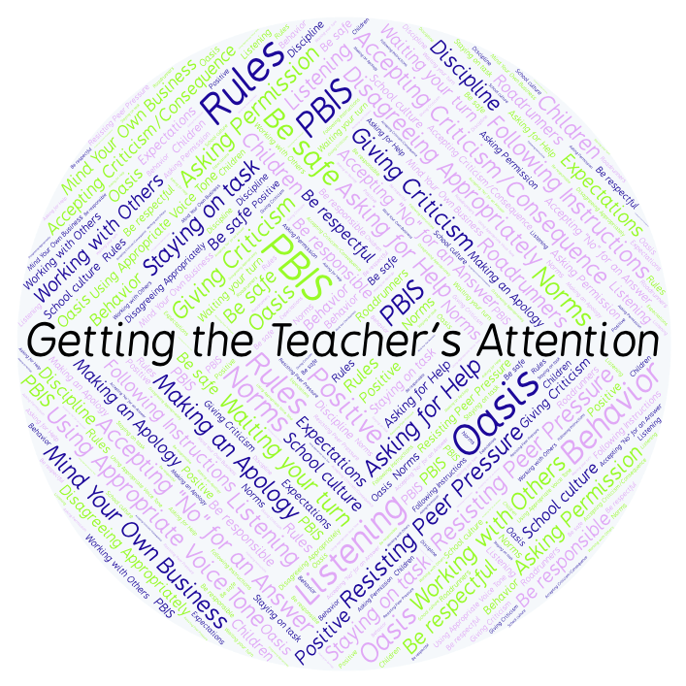
PBIS Social Skills
Day 3

Slide 2
Getting the Teacher’s Attention
Remember, this week we are talking about Getting the Teacher’s Attention.
Let’s review the four steps.

Slide 3
Getting the Teacher’s Attention
Step 1: Look at the teacher.

Slide 4
Getting the Teacher’s Attention
Step 2: Raise your hand and stay calm.

Slide 5
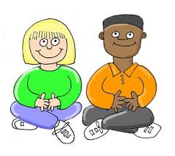
Getting the Teacher’s Attention
Step 3: Wait until the teacher says your name.

Slide 6
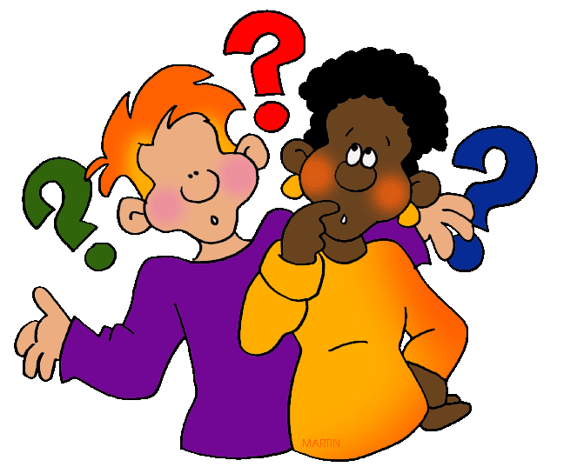
Getting the Teacher’s Attention
Step 4: Ask your question or make your statement.

Slide 7
Getting the Teacher’s Attention
When you use the steps to Getting the Teacher’s Attention appropriately, you have a better chance to get your question answered quickly.
Okay, today we are going to talk more about the second step.
Step 2 is “Raise you hand and stay calm.”

Slide 8
Getting the Teacher’s Attention
Why do you think it is important to raise your hand and stay calm when trying to get someone’s attention?
Who would like to demonstrate trying to get my attention from your desk?

Slide 9
Getting the Teacher’s Attention
What do you think would happen if you called out to your teacher instead of raising your hand and staying calm?
Who would like to demonstrate a non-example of this step while trying to get my attention?

Slide 10
Getting the Teacher’s Attention
Work in groups on a laptop to write a Diamante Poem about getting the teacher’s attention.
Consider using the ReadWriteThink program to compos your poem.
When you are finished, please print the final poem or email it to your teacher.

Slide 11
Getting the Teacher’s Attention
Project for the Week
Work with your table group to write a “recipe” for getting your teacher’s attention.
You may create your recipe by hand, or consider using one of the templates here. Look for one that says Recipe Card or Recipe Page.
Be sure to include a list of “ingredients” and instructions for getting your teacher’s attention.
Share your “recipe” with the rest of your class.

