Slide 1
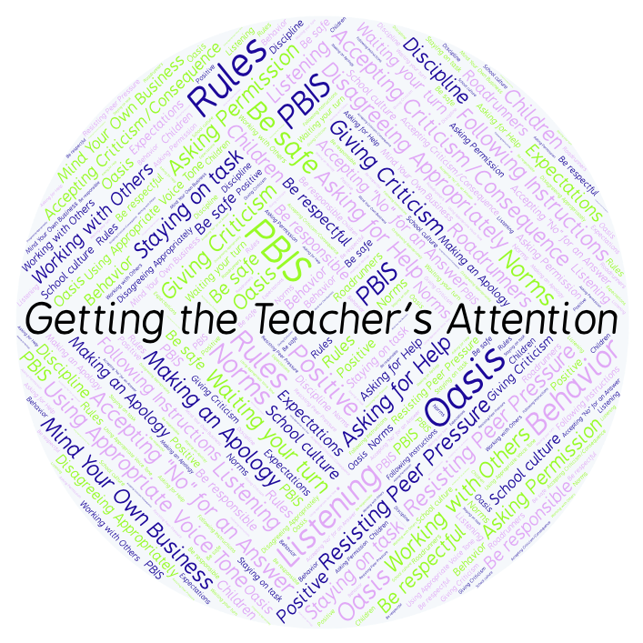
PBIS Social Skills
Day 4

Slide 2
Getting the Teacher’s Attention
Remember, this week we are talking about Getting the Teacher’s Attention.
Let’s review the four steps.

Slide 3
Getting the Teacher’s Attention
Step 1: Look at the teacher.

Slide 4
Getting the Teacher’s Attention
Step 2: Raise your hand and stay calm.

Slide 5
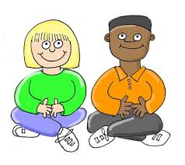
Getting the Teacher’s Attention
Step 3: Wait until the teacher says your name.

Slide 6
Getting the Teacher’s Attention
Step 4: Ask your question or make your statement.

Slide 7
Getting the Teacher’s Attention
When you use the steps to Getting the Teacher’s Attention appropriately, you have a better chance to get your question answered quickly.
Okay, today we are going to talk more about the third and fourth steps.
Step 3 is “Wait until the teacher says your name.”

Slide 8
Getting the Teacher’s Attention
Why do you think it is important to wait until the teacher says your name before speaking?
Turn to your elbow partner and practice step 3 by following the steps we have learned.

Slide 9
Getting the Teacher’s Attention
What do you think would happen if you started speaking before the teacher said your name?
Turn to your elbow partner and demonstrate a non-example of this step while trying to get their attention.

Slide 10
Getting the Teacher’s Attention
Step 4 is “Ask your question or make your statement.”
How can you begin a question? Why is it important to ask your question or make your statement clearly?
Turn to your elbow partner and practice step 4 by asking them a question.

Slide 11
Getting the Teacher’s Attention
What do you think would happen if you didn’t ask your question or make your statement clearly or politely?
Turn to your elbow partner and demonstrate a non-example of this step while asking them a question.

Slide 12
Getting the Teacher’s Attention
Log in to Edmodo and navigate to the “PBIS Social Skills” group. If you haven’t already joined, the code is w483zg.
Find the “Getting the Teacher’s Attention Discussion Prompt” and respond in writing by clicking on the Reply button.

Slide 13
Getting the Teacher’s Attention
Project for the Week
Work with your table group to write a “recipe” for getting your teacher’s attention.
You may create your recipe by hand, or consider using one of the templates here.
Be sure to include a list of “ingredients” and instructions for getting your teacher’s attention.
Share your “recipe” with the rest of your class.

