Slide 1
PBIS Social Skills
Day 5

Slide 2
Giving Criticism
Remember, this week we are talking about Giving Criticism.
Let’s review the six steps.

Slide 3
Giving Criticism
Step 1: Look at the person.

Slide 4
Giving Criticism
Step 2: Stay calm and use a pleasant voice.

Slide 5
Giving Criticism
Step 3: Say something positive or “I understand.”

Slide 6
Giving Criticism
Step 4: Describe exactly what you are criticizing.

Slide 7
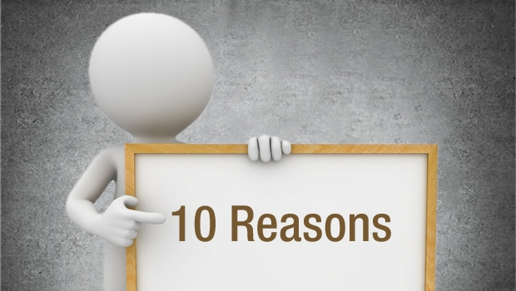
Giving Criticism
Step 5: Tell why this is a problem.

Slide 8
Giving Criticism
Step 6: Listen to the person. Be polite.

Slide 9
Giving Criticism
When you are able to give criticism appropriately you have a chance to help your friend build their skills.
Okay, today we are going to present the Projects we have been working on this week. Who would like to be the first volunteer?

