Slide 1
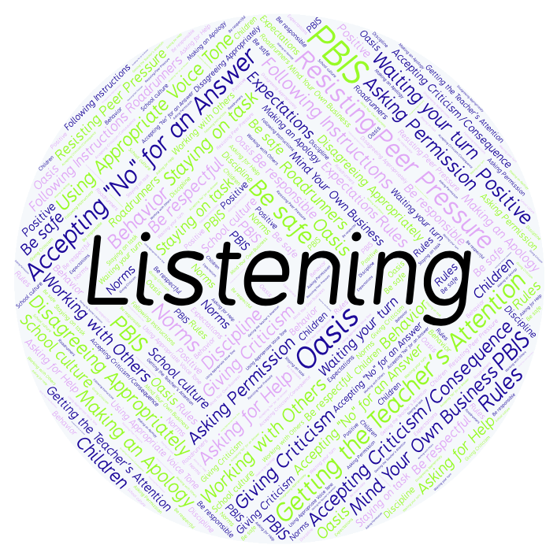
PBIS Social Skills
Day 1

Slide 2
Listening
How do you feel when people don’t listen to you? Why?
To respond to the prompt, scan the QR code to the right from the Padlet app or click here.
Once you have opened the Padlet, click on the plus sign ( + ) in the bottom right hand corner and enter your response.
Look around the Padlet to see what others have said.

Slide 3
Listening
This week we are going to talk about Listening.
Let’s learn the three steps all students must do when asked to listen.

Slide 4
Listening
Step 1: Look at the person who is talking and remain quiet.

Slide 5
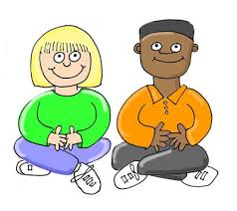
Listening
Step 2: Wait until the other person is done talking before you speak.

Slide 6
Listening
Step 3: Show you heard the person by nodding your head, saying “OK,” “That’s interesting,” etc.

Slide 7
Listening
We will be practicing these steps all week.
When you are able to listen appropriately, you are more likely to understand the lesson and be able to complete your assignment.

Slide 8
Listening
Project for the Week
Create a quiz about being a better listener that your classmates could take. You may create your quiz using paper and pencil or consider using Google Forms.
Be sure to include:
at least 5 questions that ask about the steps we’ve learned.
situations that could happen in real life.

