Slide 1
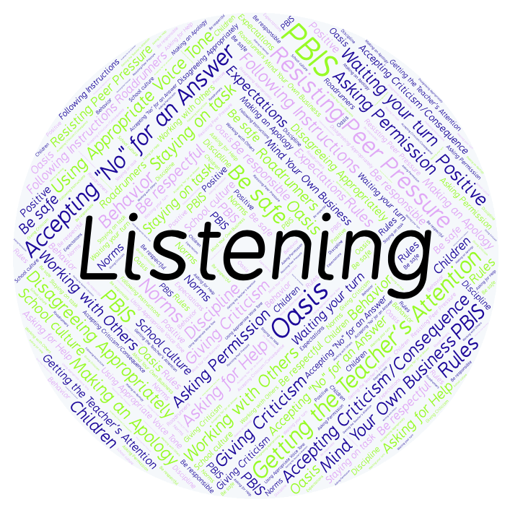
PBIS Social Skills
Day 2

Slide 2
Listening
Remember, this week we are talking about Listening.
Let’s review the three steps.

Slide 3
Listening
Step 1: Look at the person who is talking and remain quiet.

Slide 4
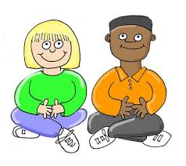
Listening
Step 2: Wait until the other person is done talking before you speak.

Slide 5
Listening
Step 3: Show you heard the person by nodding your head, saying “OK,” “That’s interesting,” etc.

Slide 6
Listening
When you are able to listen appropriately, you are more likely to understand the lesson and be able to complete your assignment.
Okay, today we are going to talk more about the first step.
Step 1 is “Look at the person who is talking and remain quiet.”

Slide 7
Listening
Why do you think it is important to look at someone when you are listening to them?
Turn to your elbow partner and practice step 1 while you are explaining your answer to this question.

Slide 8
Listening
What do you think would happen if you didn’t look at someone when you were listening to them?
Turn to your elbow partner and demonstrate a non-example of this step while explaining your answer.

Slide 9
Listening
Let’s watch Howard B. Wigglebottom learn how to listen.

Slide 10
Listening
Turn to your elbow partner and have a discussion:
In the video you just watched, how did not listening get Howard in trouble?
When he decided to become a better listener, how did he use the steps we’ve learned?
Which step do you think you need to work on the most? Why?

Slide 11
Listening
Project for the Week
Create a quiz that your classmates could take about being a better listener. You may create your quiz using paper and pencil or consider using Google Forms.
Be sure to include:
at least 5 questions that ask about the steps we’ve learned.
situations that could happen in real life.

