Slide 1
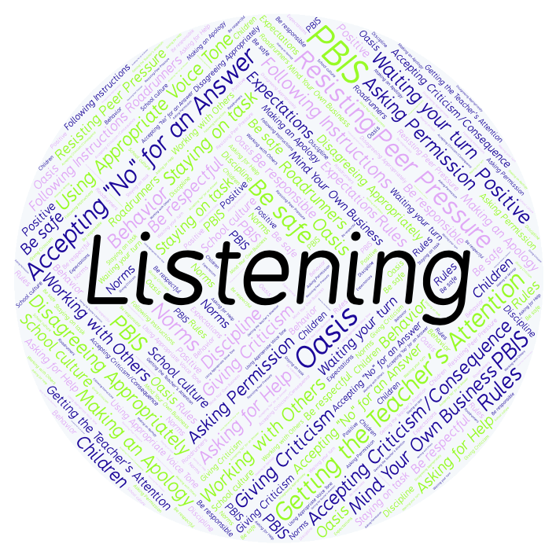
PBIS Social Skills
Day 3

Slide 2
Listening
Remember, this week we are talking about Listening.
Let’s review the three steps.

Slide 3
Listening
Step 1: Look at the person who is talking and remain quiet.

Slide 4
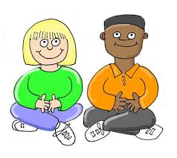
Listening
Step 2: Wait until the other person is done talking before you speak.

Slide 5
Listening
Step 3: Show you heard the person by nodding your head, saying “OK,” “That’s interesting,” etc.

Slide 6
Listening
When you are able to listen appropriately, you are more likely to understand the lesson and be able to complete your assignment.
Okay, today we are going to talk more about the second step.
Step 2 is “Wait until the other person is done talking before you speak.”

Slide 7
Listening
Why should you wait until the other person is done talking before you speak?
Who would like to come to the front of the classroom and practice step 2 with a partner?

Slide 8
Listening
What do you think would happen if you didn’t wait until the other person was done talking before you speak?
Who would like to come the front of the class and demonstrate a non-example of this step with a partner?

Slide 9
Listening
Work in groups on a laptop to write a Haiku Poem about listening.
Consider using the ReadWriteThink program to compose your poem.
When you are finished, please print the final poem or email it to your teacher.

Slide 10
Listening
Project for the Week
Create a quiz that your classmates could take about being a better listener. You may create your quiz using paper and pencil or consider using Google Forms.
Be sure to include:
at least 5 questions that ask about the steps we’ve learned.
situations that could happen in real life.

