Slide 1
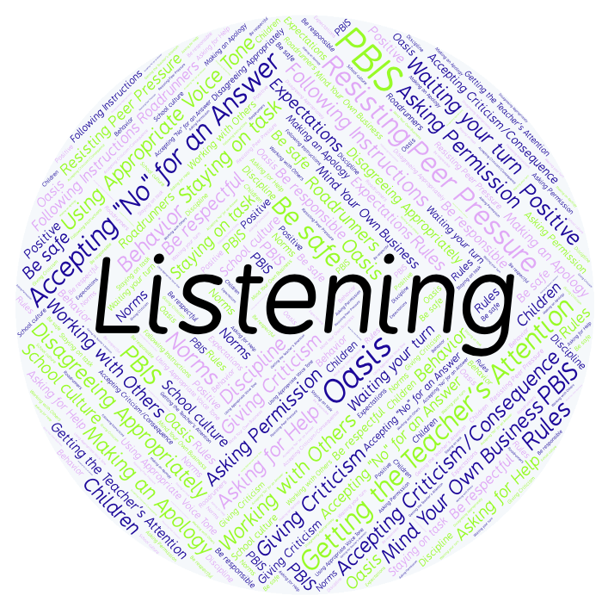
PBIS Social Skills
Day 4

Slide 2
Listening
Remember, this week we are talking about Listening.
Let’s review the three steps.

Slide 3
Listening
Step 1: Look at the person who is talking and remain quiet.

Slide 4
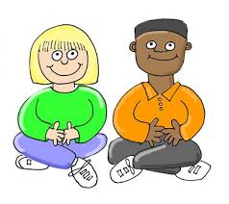
Listening
Step 2: Wait until the other person is done talking before you speak.

Slide 5
Listening
Step 3: Show you heard the person by nodding your head, saying “OK,” “That’s interesting,” etc.

Slide 6
Listening
When you are able to listen appropriately, you are more likely to understand the lesson and be able to complete your assignment.
Okay, today we are going to talk more about the third step.
Step 2 is “Show you heard the person by nodding your head, saying ‘OK,’ ‘That’s interesting,’ etc.

Slide 7
Listening
Why is important to acknowledge what the other person has said? What are some other words you could use to show you heard the person?
Turn to your elbow partner and practice step 3.

Slide 8
Listening
What do you think would happen if you didn’t show that you heard the other person? How would the other person feel?
Turn to your elbow partner and demonstrate a non-example of this step.

Slide 9
Listening
Log in to Edmodo and navigate to the “PBIS Social Skills” group. If you haven’t already joined, the code is w483zg.
Find the “Listening Discussion Prompt” and respond in writing by clicking on the Reply button.

Slide 10
Listening
Project for the Week
Create a quiz that your classmates could take about being a better listener. You may create your quiz using paper and pencil or consider using Google Forms.
Be sure to include:
at least 5 questions that ask about the steps we’ve learned.
situations that could happen in real life.

