Slide 1
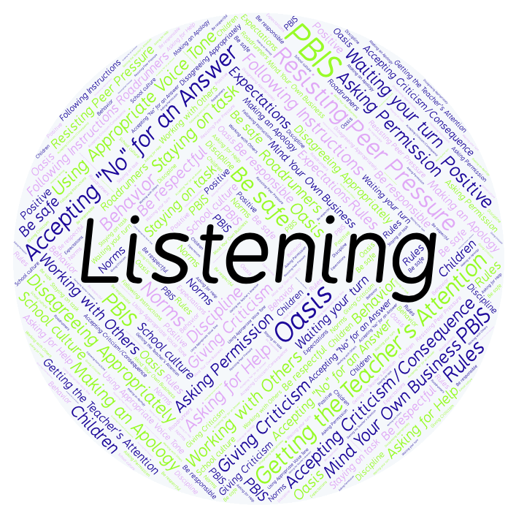
PBIS Social Skills
Day 5

Slide 2
Listening
Remember, this week we are talking about Listening.
Let’s review the three steps.

Slide 3
Listening
Step 1: Look at the person who is talking and remain quiet.

Slide 4
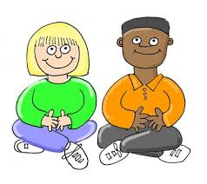
Listening
Step 2: Wait until the other person is done talking before you speak.

Slide 5
Listening
Step 3: Show you heard the person by nodding your head, saying “OK,” “That’s interesting,” etc.

Slide 6
Listening
When you are able to listen appropriately, you are more likely to understand the lesson and be able to complete your assignment.
Okay, today we are going to present the Projects we have been working on this week. Who would like to be the first volunteer?

