Slide 1
PBIS Social Skills
Day 2

Slide 2
Making an Apology
Remember, this week we are talking about Making and Apology.
Let’s review the five steps.

Slide 3
Making an Apology
Step 1: Look at the person.

Slide 4
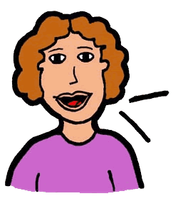
Making an Apology
Step 2: Use a serious, sincere voice.

Slide 5
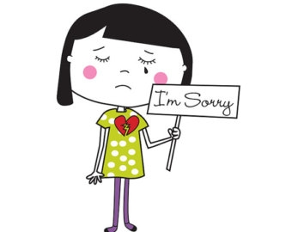
Making an Apology
Step 3: Say “I’m sorry for…” or “I want to apologize…”

Slide 6
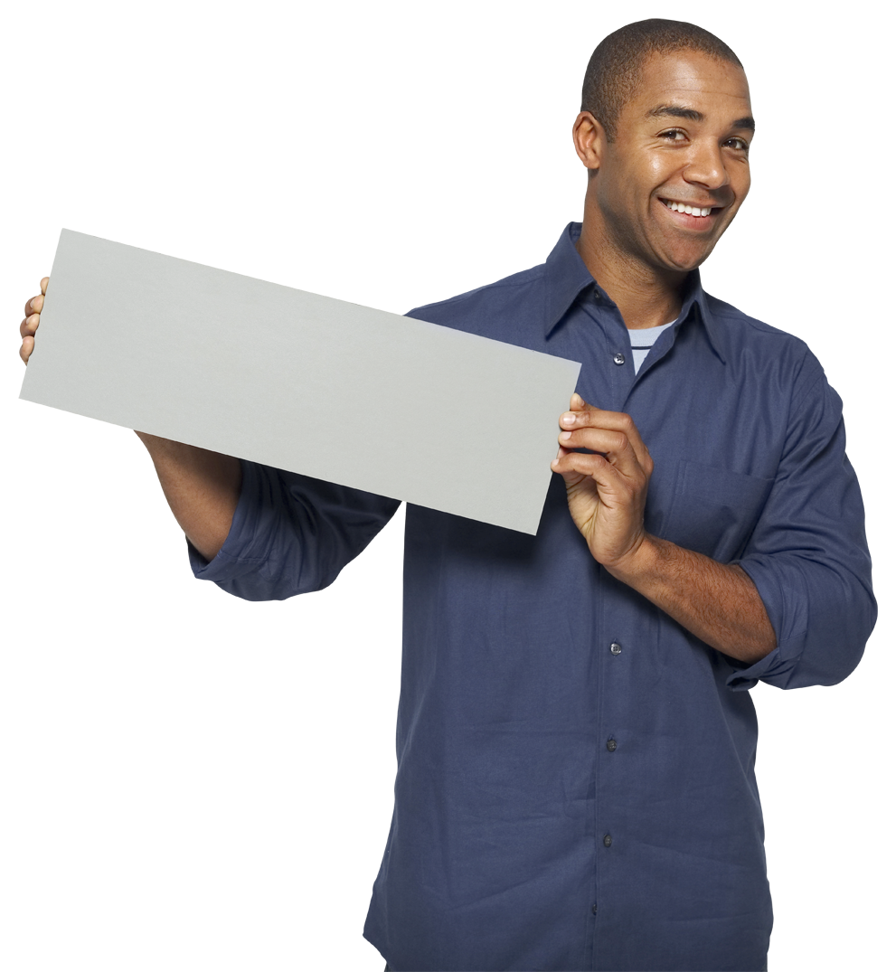
Making an Apology
Step 4: Explain how you plan to do better in the future.
Here’s how I’ll do better…

Slide 7
Making an Apology
Step 5: Say “Thanks for listening.”

Slide 8
Making an Apology
When you are able to make an apology you show others you care.
Okay, today we are going to talk more about the first step.
Step 1 is “Look at the person.”

Slide 9
Making an Apology
Why do you think it is important to look at someone when you are making an apology?
Turn to your elbow partner and practice step 1.

Slide 10
Making an Apology
How do you think the other person would feel if you didn’t look at them when making an apology?
Turn to your elbow partner and demonstrate a non-example of this step.

Slide 11
Making an Apology
Here’s a song to help you remember when to say “I’m Sorry!”

Slide 12
Making an Apology
Have a discussion with your elbow partner:
Have you ever found yourself in a situation like the ones described in the video you just watched? How did you handle it? What could you have done differently?
Which step do you think you need to work on the most? Why?

Slide 13
Making an apology
Project for the Week
Work with your table group to write a radio interview explaining how to make an apology. Consider using Garage Band to record your broadcast.
Be sure to include:
the five steps you learned for making an apology and why they are important.
explanations and examples of the five steps.
at least two people speaking.
Perform the interview for your class.

