Slide 1
PBIS Social Skills
Day 3

Slide 2
Making an Apology
Remember, this week we are talking about Making and Apology.
Let’s review the five steps.

Slide 3
Making an Apology
Step 1: Look at the person.

Slide 4
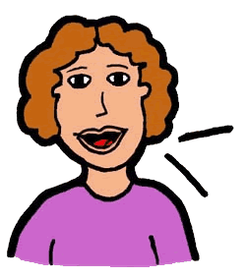
Making an Apology
Step 2: Use a serious, sincere voice.

Slide 5
Making an Apology
Step 3: Say “I’m sorry for…” or “I want to apologize…”

Slide 6
Making an Apology
Step 4: Explain how you plan to do better in the future.
Here’s how I’ll do better…

Slide 7
Making an Apology
Step 5: Say “Thanks for listening.”

Slide 8
Making an Apology
When you are able to make an apology you show others you care.
Okay, today we are going to talk more about the second and third steps.
Step 2 is “Use a serious, sincere voice.”

Slide 9
Making an Apology
Why do you think it is important to use a serious, sincere voice when making an apology?
Who would like to come to the front of the classroom and practice step 2 with a partner?

Slide 10
Making an Apology
What do you think would happen if you didn’t use a serious, sincere voice when making an apology? How would the other person feel?
Who would like to come to the front of the classroom and demonstrate a non-example of this step?

Slide 11
Making an Apology
Step 3 is “Say ‘I’m sorry for…’ or ‘I want to apologize…’.”
Why is it important to use these words and to explain what you are sorry for? Are there any other words you could use?
Who would like to come to the front of the classroom and practice step 3?

Slide 12
Making an Apology
What do you think would happen if you just said “Sorry” in a silly or sarcastic voice and didn’t explain what you were sorry for? How would that make the other person feel?
Who would like to come to the front of the classroom and demonstrate a non-example of this step?

Slide 13
Making an Apology
Work in groups on a laptop to write a Diamante Poem about making an apology.
Consider using the ReadWriteThink program to compose your poem.
When you are finished, please print the final poem or email it to your teacher.

Slide 14
Making an apology
Project for the Week
Work with your table group to write a radio interview explaining how to make an apology. Consider using Garage Band to record your broadcast.
Be sure to include:
the five steps you learned for making an apology and why they are important.
explanations and examples of the five steps.
at least two people speaking.
Perform the interview for your class.

