Slide 1
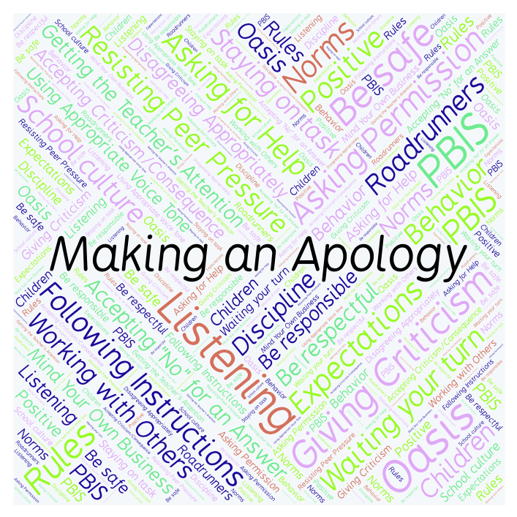
PBIS Social Skills
Day 4

Slide 2
Making an Apology
Remember, this week we are talking about Making and Apology.
Let’s review the five steps.

Slide 3
Making an Apology
Step 1: Look at the person.

Slide 4
Making an Apology
Step 2: Use a serious, sincere voice.

Slide 5
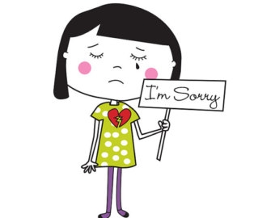
Making an Apology
Step 3: Say “I’m sorry for…” or “I want to apologize…”

Slide 6
Making an Apology
Step 4: Explain how you plan to do better in the future.
Here’s how I’ll do better…

Slide 7
Making an Apology
Step 5: Say “Thanks for listening.”

Slide 8
Making an Apology
When you are able to make an apology you show others you care.
Okay, today we are going to talk more about the fourth and fifth steps.
Step 4 is “Explain how you plan to do better in the future.”

Slide 9
Making an Apology
Why is it important to explain how your plan to do better in the future?
Turn to your elbow partner and practice step 4.

Slide 10
Making an Apology
What do you think would happen if you didn’t explain how you plan to do better in the future? How would the other person feel?
Turn to your elbow partner and demonstrate a non-example of this step.

Slide 11
Making an Apology
Step 5 is “Say ‘Thanks for listening’.”
Why is it important to say “Thanks for listening” after making an apology? What does this show the other person?
Turn to your elbow partner and practice step 5.

Slide 12
Making an Apology
What do you think would happen if you didn’t say “Thanks for listening” after making an apology and just walked away? How would the other person feel now?
Turn to your elbow partner and demonstrate a non-example of this step.

Slide 13
Making an Apology
Log in to Edmodo and navigate to the “PBIS Social Skills” group. If you haven’t already joined, the code is w48zg.
Find the “Making an Apology Discussion Prompt” and respond in writing by clicking on the Reply button.

Slide 14
Making an apology
Project for the Week
Work with your table group to write a radio interview explaining how to make an apology. Consider using Garage Band to record your broadcast.
Be sure to include:
the five steps you learned for making an apology and why they are important.
explanations and examples of the five steps.
at least two people speaking.
Perform the interview for your class.

