Slide 1
PBIS Social Skills
Day 5

Slide 2
Making an Apology
Remember, this week we are talking about Making and Apology.
Let’s review the five steps.

Slide 3
Making an Apology
Step 1: Look at the person.

Slide 4
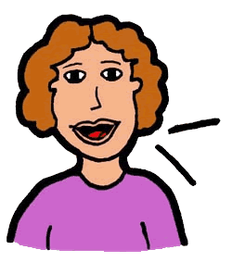
Making an Apology
Step 2: Use a serious, sincere voice.

Slide 5
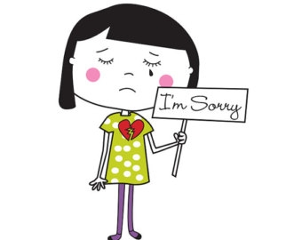
Making an Apology
Step 3: Say “I’m sorry for…” or “I want to apologize…”

Slide 6
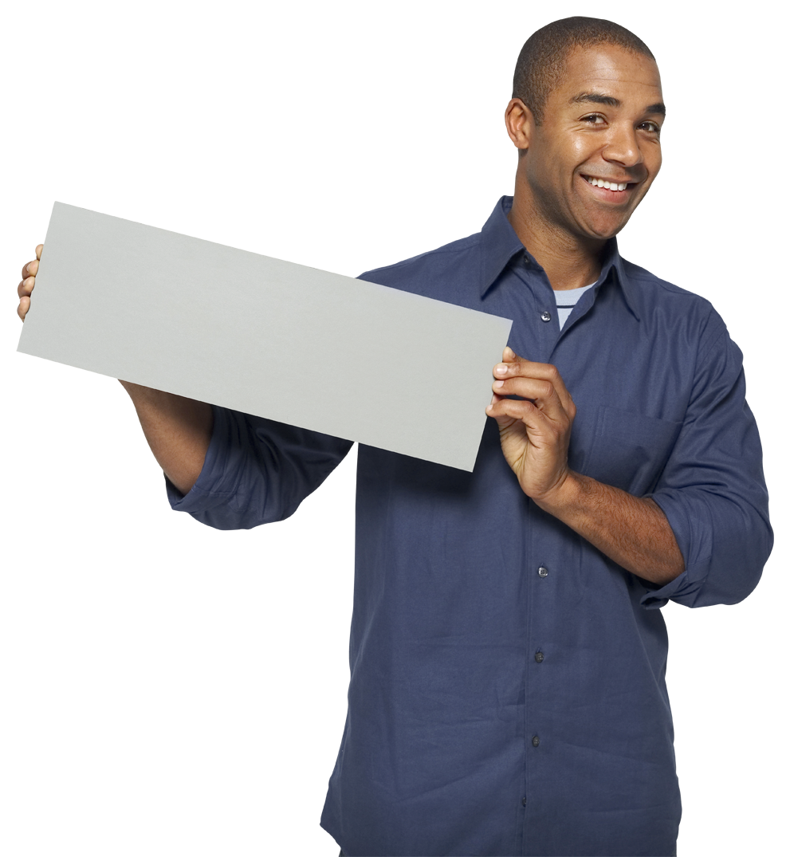
Making an Apology
Step 4: Explain how you plan to do better in the future.
Here’s how I’ll do better…

Slide 7
Making an Apology
Step 5: Say “Thanks for listening.”

Slide 8
Working with Others
When you are able to make an apology you show others you care.
Okay, today we are going to present the Projects we have been working on this week. Who would like to be the first volunteer?

