Slide 1
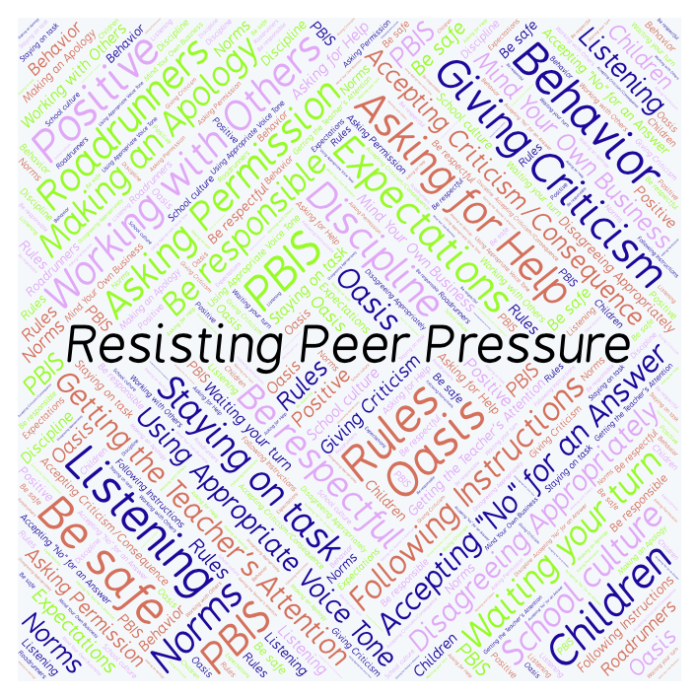
PBIS Social Skills
Day 1

Slide 2
Resisting Peer Pressure
Describe a time when someone tried to pressure you into doing something. How did you handle it?
To respond to the prompt, scan the QR code to the right from the Padlet app or click here.
Once you have opened the Padlet, click on the plus sign ( + ) in the bottom right hand corner and enter your response.
Look around the Padlet to see what others have said.

Slide 3
Resisting Peer Pressure
This week we are going to talk about Resisting Peer Pressure
Let’s learn the six steps all students must do when resisting peer pressure

Slide 4
Resisting Peer Pressure
Step 1: Look at the person.

Slide 5
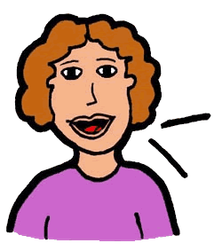
Resisting Peer Pressure
Step 2: Use a calm voice.

Slide 6
Resisting Peer Pressure
Step 3: Say clearly you do not want to participate.

Slide 7
Resisting Peer Pressure
Step 4: Suggest something else to do.

Slide 8
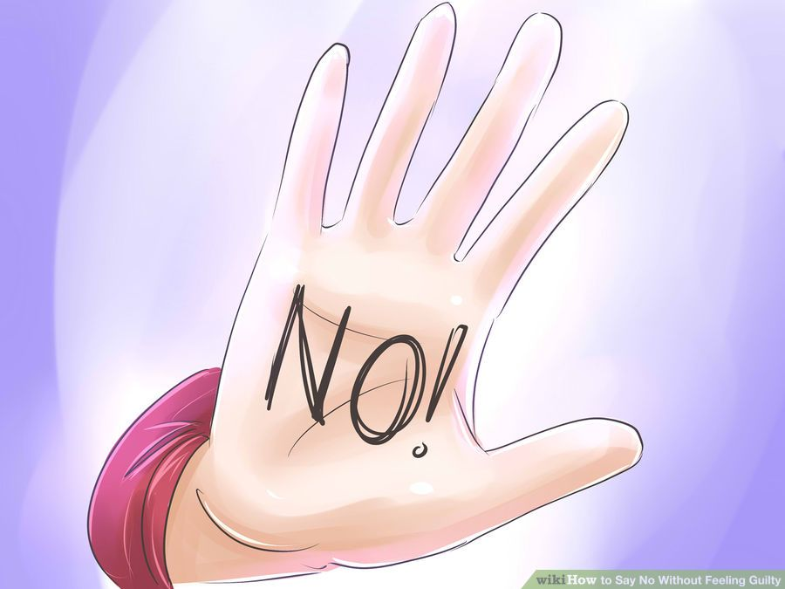
Resisting Peer Pressure
Step 5: If necessary, continue to say “No.”

Slide 9
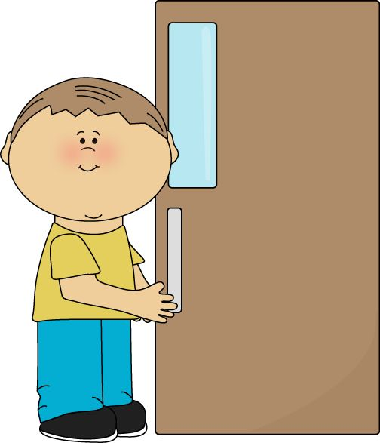
Resisting Peer Pressure
Step 6: Leave the situation.

Slide 10
Resisting Peer Pressure
We will be practicing these steps all week.
When you are able to demonstrate Resisting Peer Pressure appropriately you may be able to stay out of danger and/or trouble.

Slide 11
Resisting Peer Pressure
Project for the Week
Work with your table group to write dialog for a skit about Resisting Peer Pressure
Be sure to include:
a real-world situation that you might see here at school or at home.
The six steps you learned for Resisting Peer Pressure.
Perform the skit for your class and consider turning it into a movie using iMovie.

