Slide 1
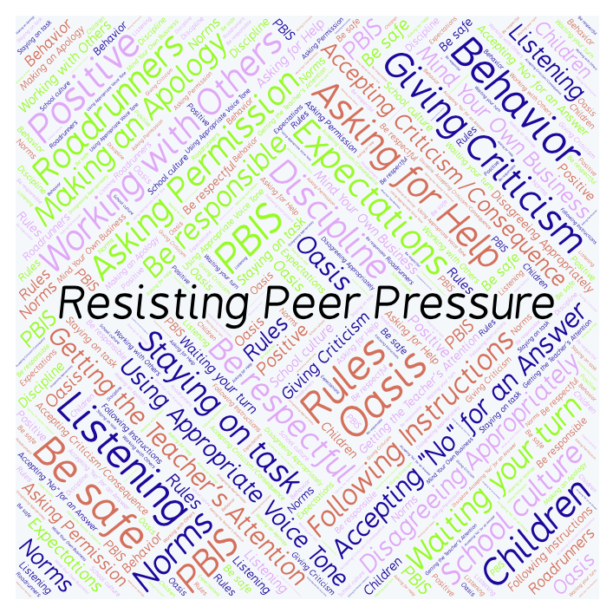
PBIS Social Skills
Day 2

Slide 2
Resisting Peer Pressure
Remember, this week we are talking about Working with Others.
Let’s review the six steps.

Slide 3
Resisting Peer Pressure
Step 1: Look at the person.

Slide 4
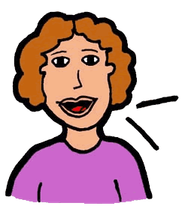
Resisting Peer Pressure
Step 2: Use a calm voice.

Slide 5
Resisting Peer Pressure
Step 3: Say clearly you do not want to participate.

Slide 6
Resisting Peer Pressure
Step 4: Suggest something else to do.

Slide 7
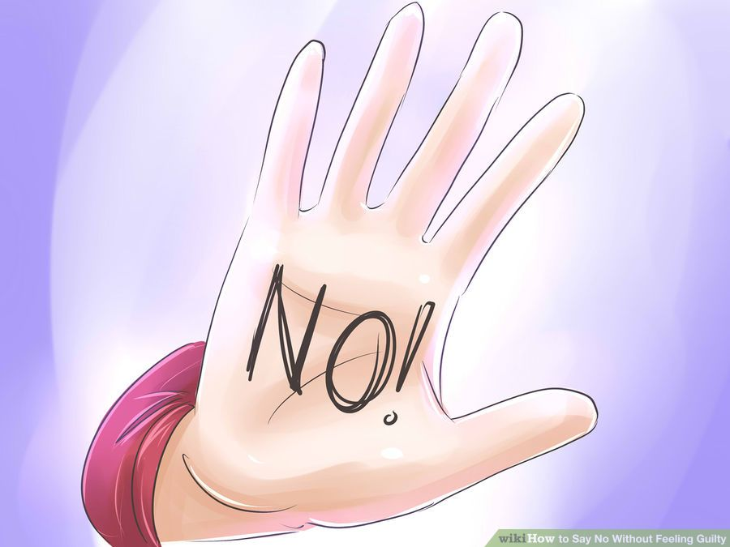
Resisting Peer Pressure
Step 5: If necessary, continue to say “No.”

Slide 8
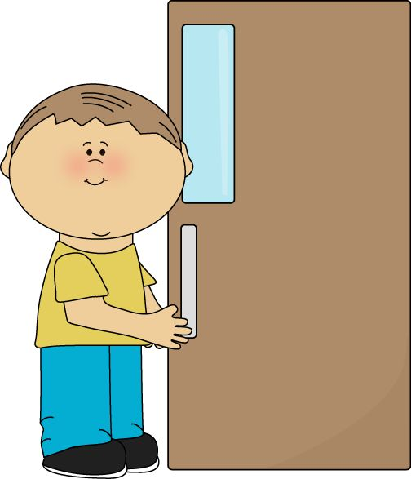
Resisting Peer Pressure
Step 6: Leave the situation.

Slide 9
Resisting Peer Pressure
When you are able to demonstrate Resisting Peer Pressure appropriately you may be able to stay out of danger and/or trouble.
Okay, today we are going to talk more about the first and second steps.
Step 1 is “Look at the Person.”

Slide 10
Resisting Peer Pressure
Why do you think it is important to look at someone when you are trying to resist doing something you shouldn’t do?
Turn to your elbow partner and practice step 1.

Slide 11
Resisting Peer Pressure
What do you think would happen if you didn’t look at the person when you are trying to resist doing something you shouldn’t do?
Turn to your elbow partner and demonstrate a non-example of this step.

Slide 12
Resisting Peer Pressure
Step 2 is “Use a calm voice.
Why do you think it is important to use a calm voice when trying to resist doing something you shouldn’t do?
Turn to your elbow partner and practice step 2.

Slide 13
Resisting Peer Pressure
What do you think would happen if you used and angry or emotional voice when trying to resist doing something you shouldn’t do?
Turn to your elbow partner and demonstrate a non-example of this step.

Slide 14
Resisting Peer Pressure
Let’s learn how to resist peer pressure!

Slide 15
Resisting Peer Pressure
Have a discussion with your elbow partner:
Think about the steps to Resisting Peer Pressure we learned earlier in this NearPod and then think about the steps described in the video you just watched. How are they the same? How are they different?
Which step do you think you need to work on the most? Why?

Slide 16
Resisting Peer Pressure
Project for the Week
Work with your table group to write dialog for a skit about Resisting Peer Pressure
Be sure to include:
a real-world situation that you might see here at school or at home.
The six steps you learned for Resisting Peer Pressure.
Perform the skit for your class and consider turning it into a movie using iMovie.

