Slide 1
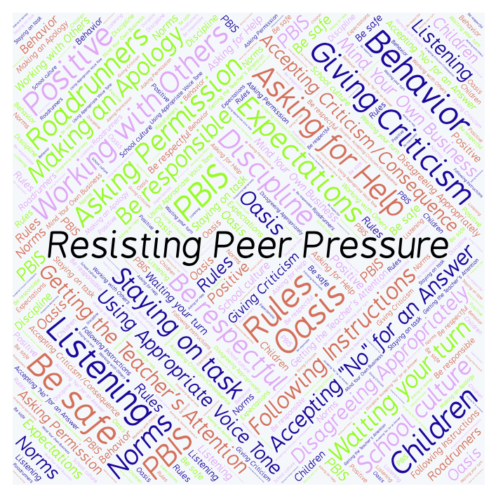
PBIS Social Skills
Day 3

Slide 2
Resisting Peer Pressure
Remember, this week we are talking about Working with Others.
Let’s review the six steps.

Slide 3
Resisting Peer Pressure
Step 1: Look at the person.

Slide 4
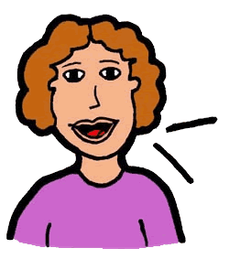
Resisting Peer Pressure
Step 2: Use a calm voice.

Slide 5
Resisting Peer Pressure
Step 3: Say clearly you do not want to participate.

Slide 6
Resisting Peer Pressure
Step 4: Suggest something else to do.

Slide 7
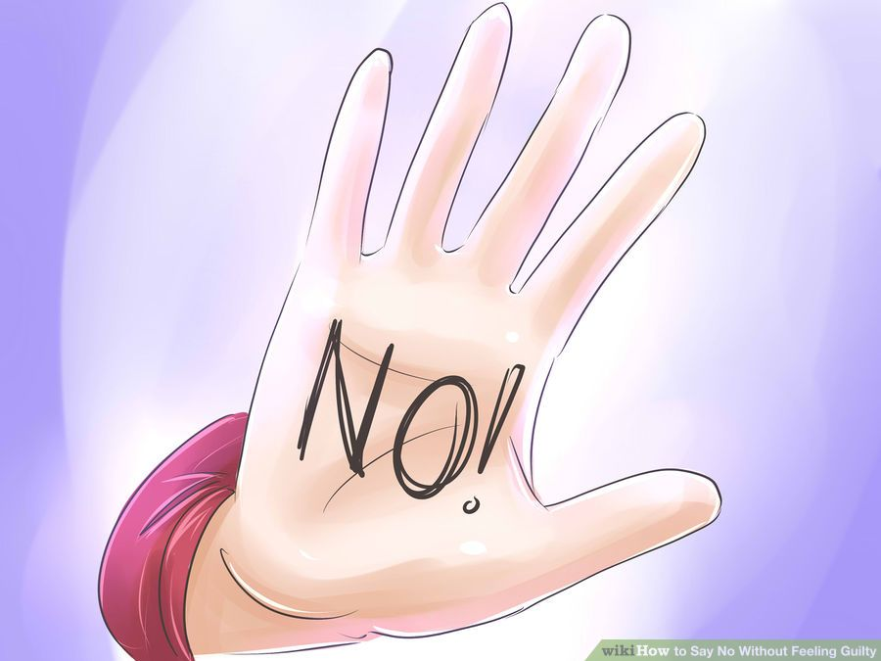
Resisting Peer Pressure
Step 5: If necessary, continue to say “No.”

Slide 8
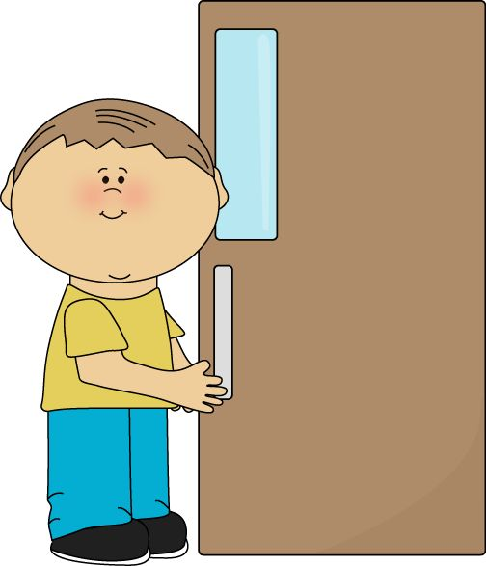
Resisting Peer Pressure
Step 6: Leave the situation.

Slide 9
Resisting Peer Pressure
When you are able to demonstrate Resisting Peer Pressure appropriately you may be able to stay out of danger and/or trouble.
Okay, today we are going to talk more about the third and fourth steps.
Step 3 is “Say clearly you do not want to participate.”

Slide 10
Resisting Peer Pressure
Why do you think it is important to say in very clear terms that you do not want to participate?
Who would like to come to the front of the classroom and practice step 3?

Slide 11
Resisting Peer Pressure
What do you think would happen if you didn’t say clearly that you do not want to participate? What if you wavered or weren’t clear?
Who would like to come to the front of the classroom and demonstrate a non-example of this step?

Slide 12
Resisting Peer Pressure
Step 4 is “Suggest something else to do.
How can suggesting something else to do help the situation?
Who would like to come to the front of the classroom and practice step 4?

Slide 13
Resisting Peer Pressure
What do you think would happen if you didn’t suggest something else to do?
Who would like to come to the front of the classroom and demonstrate a non-example of this step?

Slide 14
Resisting Peer Pressure
Work in groups on a laptop to write a Haiku Poem about resisting peer pressure.
Consider using the ReadWriteThink program to compose your poem.
When you are finished, please print the final poem or email it to your teacher.

Slide 15
Resisting Peer Pressure
Project for the Week
Work with your table group to write dialog for a skit about Resisting Peer Pressure
Be sure to include:
a real-world situation that you might see here at school or at home.
The six steps you learned for Resisting Peer Pressure.
Perform the skit for your class and consider turning it into a movie using iMovie.

