Slide 1
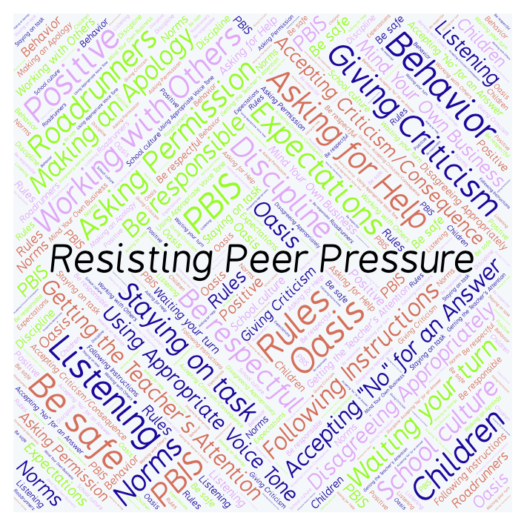
PBIS Social Skills
Day 4

Slide 2
Resisting Peer Pressure
Remember, this week we are talking about Working with Others.
Let’s review the six steps.

Slide 3
Resisting Peer Pressure
Step 1: Look at the person.

Slide 4
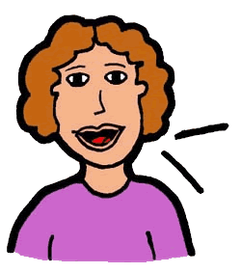
Resisting Peer Pressure
Step 2: Use a calm voice.

Slide 5
Resisting Peer Pressure
Step 3: Say clearly you do not want to participate.

Slide 6
Resisting Peer Pressure
Step 4: Suggest something else to do.

Slide 7
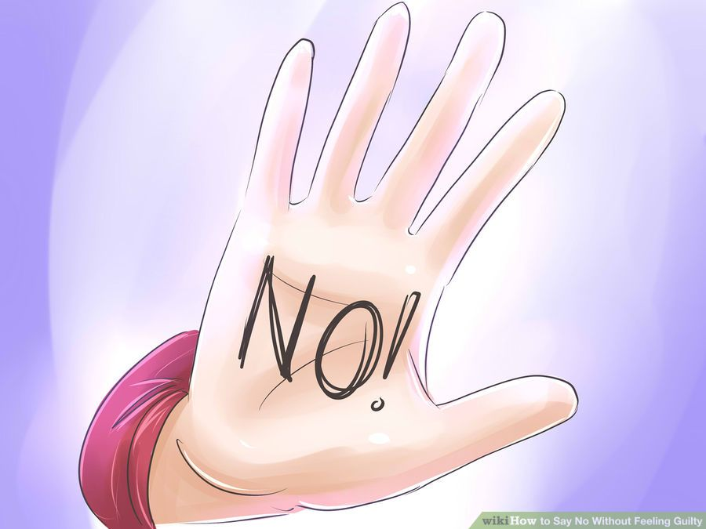
Resisting Peer Pressure
Step 5: If necessary, continue to say “No.”

Slide 8
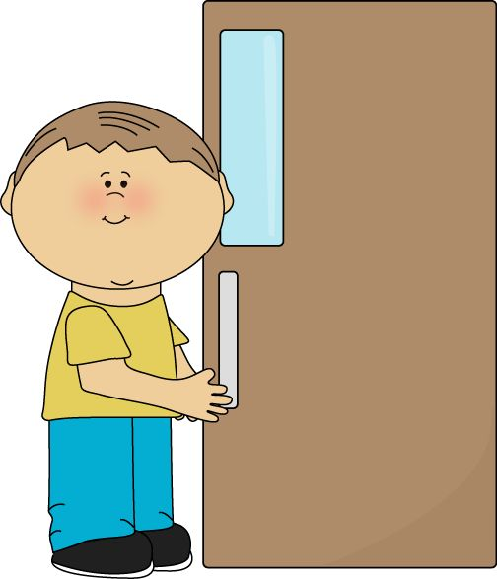
Resisting Peer Pressure
Step 6: Leave the situation.

Slide 9
Resisting Peer Pressure
When you are able to demonstrate Resisting Peer Pressure appropriately you may be able to stay out of danger and/or trouble.
Okay, today we are going to talk more about the fifth and sixth steps.
Step 5 is “If necessary, continue to say ‘No’.”

Slide 10
Resisting Peer Pressure
Why is important to continue saying “no” when someone is trying to talk you into something you shouldn’t do?
Turn to your elbow partner and practice step 5.

Slide 11
Resisting Peer Pressure
What do you think would happen if you didn’t continue to say “no?” What might the other person think?
Turn to your elbow partner and demonstrate a non-example of this step.

Slide 12
Resisting Peer Pressure
Step 6 is “Leave the situation.”
Why might it sometimes be important to leave the situation and stop talking to the person?
Turn to your elbow partner and practice step 6.

Slide 13
Resisting Peer Pressure
What do you think might happen if you didn’t leave the situation?
Turn to your elbow partner and demonstrate a non-example of this step.

Slide 14
Resisting Peer Pressure
Log in to Edmodo and navigate to the “PBIS Social Skills” group. If you haven’t already joined, the code is w483zg.
Find the “Resisting Peer Pressure Discussion Prompt” and respond in writing by clicking on the Reply button.

Slide 15
Resisting Peer Pressure
Project for the Week
Work with your table group to write dialog for a skit about Resisting Peer Pressure
Be sure to include:
a real-world situation that you might see here at school or at home.
The six steps you learned for Resisting Peer Pressure.
Perform the skit for your class and consider turning it into a movie using iMovie.

