Slide 1
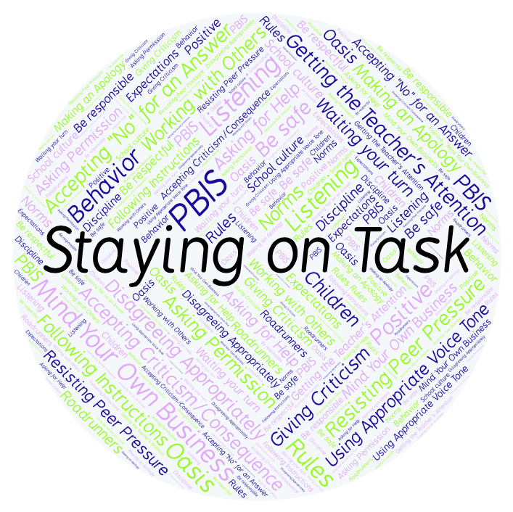
PBIS Social Skills
Day 2

Slide 2
Staying on Task
Remember, this week we are talking about Staying on Task.
Let’s review the five steps.

Slide 3
Staying on Task
Step 1: Look at your task or assignment.

Slide 4
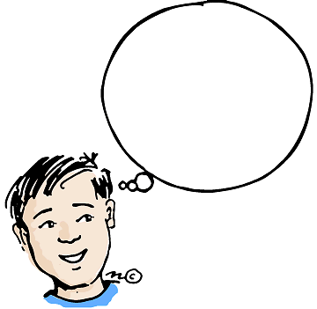
Staying on Task
Step 2: Think about the steps needed to complete the task.
What are my
next steps?

Slide 5
Staying on Task
Step 3: Focus all of your attention on the task.

Slide 6
Staying on Task
Step 4: Stop working only when instructed.
Keep
Working!

Slide 7
Staying on Task
Step 5: Ignore distractions and interruptions.

Slide 8
Staying on Task
When you are able to demonstrate Saying on Task appropriately you have a better chance of completing your assignments on time.
Okay, today we are going to talk more about the first and second step.
Step 1 is “Look at your task or assignment.”

Slide 9
Staying on Task
Why is it important to start by looking at your task or assignment?
Turn to your elbow partner and practice step 1.

Slide 10
Staying on Task
What do you think would happen if you didn’t bother to start by looking at your assignment?
Turn to your elbow partner and demonstrate a non-example of this step.

Slide 11
Staying on Task
Step 2 is “Think about the steps needed to complete the task.”
Why is important to think about the steps you need to take and plan how to complete the task?
Turn to your elbow partner and practice step 2.

Slide 12
Staying on Task
What do you think would happen if you didn’t bother to think about the steps needed and plan how to complete the task?
Turn to your elbow partner and demonstrate a non-example of this step.

Slide 13
Staying on Task
Here’s some more information about staying on task!

Slide 14
Staying on Task
Have a discussion with your elbow partner:
How are the seven steps in the video you just watched similar to the five steps we are learning this week? Are there any differences?
Which step do you think you need to work on the most? Why?

Slide 15
Staying on Task
Project of the Week
Work with your table group to create a calendar for next month with tips and reminders about staying on task.
Be sure to include:
The five steps for staying on task.
At least five reminders about what you can do to demonstrate the five steps.
Present the calendar to your class.

