Slide 1
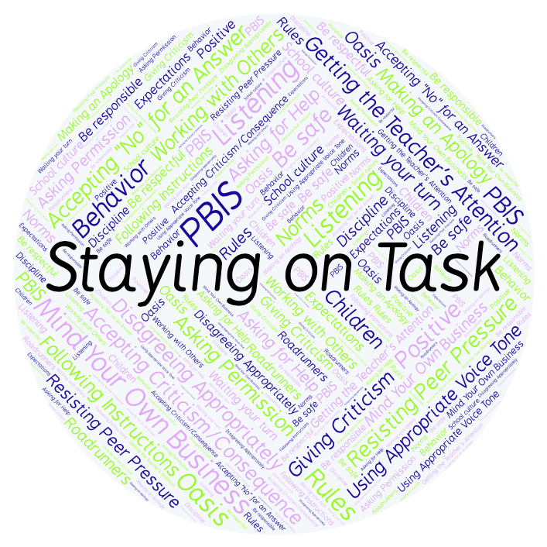
PBIS Social Skills
Day 3

Slide 2
Staying on Task
Remember, this week we are talking about Staying on Task.
Let’s review the five steps.

Slide 3
Staying on Task
Step 1: Look at your task or assignment.

Slide 4
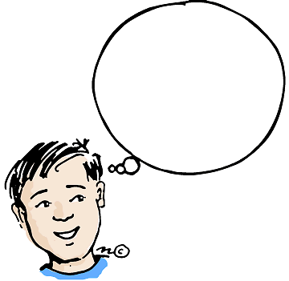
Staying on Task
Step 2: Think about the steps needed to complete the task.
What are my
next steps?

Slide 5
Staying on Task
Step 3: Focus all of your attention on the task.

Slide 6
Staying on Task
Step 4: Stop working only when instructed.
Keep
Working!

Slide 7
Staying on Task
Step 5: Ignore distractions and interruptions.

Slide 8
Staying on Task
When you are able to demonstrate Saying on Task appropriately you have a better chance of completing your assignments on time.
Okay, today we are going to talk more about the third and fourth steps.
Step 3 is “Focus all of your attention on the task.”

Slide 9
Staying on Task
Why do you think it is important to focus all your attention on the task you need to complete?
Who would like to come to the front of the classroom and practice step 3?

Slide 10
Staying on Task
What do you think would happen if you didn’t focus all of your attention on the task and let your mind wander instead?
Who would like to come to the front of the classroom and demonstrate a non-example of this step?

Slide 11
Staying on Task
Step 4 is “Stop working only when instructed.”
Why do you think it is important to keep working until you’re instructed to stop? If you finish early, what should you do?
Who would like to come to the front of the classroom and practice step 4?

Slide 12
Staying on Task
What do you think would happen if you stopped working before your were instructed to?
Who would like to come to the front of the classroom and demonstrate a non-example of this step?

Slide 13
Staying on Task
Work in groups on a laptop to write a Diamante Poem about staying on task.
Consider using the ReadWriteThink program to compose your poem.
When you are finished, please print the final poem or email it to your teacher.

Slide 14
Staying on Task
Project of the Week
Work with your table group to create a calendar for next month with tips and reminders about staying on task.
Be sure to include:
The five steps for staying on task.
At least five reminders about what you can do to demonstrate the five steps.
Present the calendar to your class.

