Slide 1
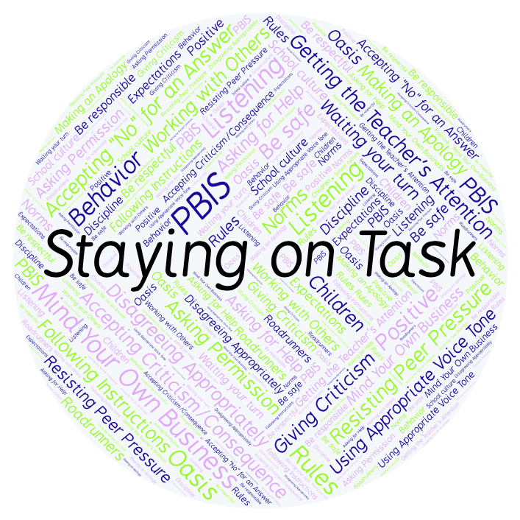
PBIS Social Skills
Day 4

Slide 2
Staying on Task
Remember, this week we are talking about Staying on Task.
Let’s review the five steps.

Slide 3
Staying on Task
Step 1: Look at your task or assignment.

Slide 4
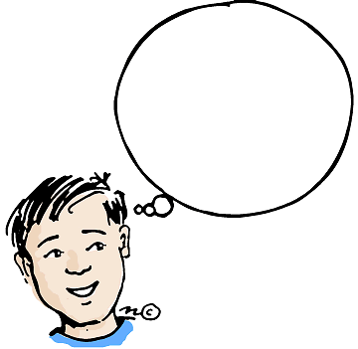
Staying on Task
Step 2: Think about the steps needed to complete the task.
What are my
next steps?

Slide 5
Staying on Task
Step 3: Focus all of your attention on the task.

Slide 6
Staying on Task
Step 4: Stop working only when instructed.
Keep
Working!

Slide 7
Staying on Task
Step 5: Ignore distractions and interruptions.

Slide 8
Staying on Task
When you are able to demonstrate Saying on Task appropriately you have a better chance of completing your assignments on time.
Okay, today we are going to talk more about the fifth step.
Step 5 is “Ignore distractions and interruptions.”

Slide 9
Staying on Task
Why is it important to ignore distractions and interruptions? What are some things that could distract or interrupt you?
Turn to your elbow partner and practice step 5.

Slide 10
Staying on Task
What do you think would happen if you didn’t ignore distractions and interruptions?
Turn to your elbow partner and demonstrate a non-example of this step.

Slide 11
Staying on Task
Log in to Edmodo and navigate to the “PBIS Social Skills” group. If you haven’t already joined, the code is w483zg.
Find the “Staying on Task Discussion Prompt” and respond in writing by clicking on the Reply button.

Slide 12
Staying on Task
Project of the Week
Work with your table group to create a calendar for next month with tips and reminders about staying on task.
Be sure to include:
The five steps for staying on task.
At least five reminders about what you can do to demonstrate the five steps.
Present the calendar to your class.

