Slide 1
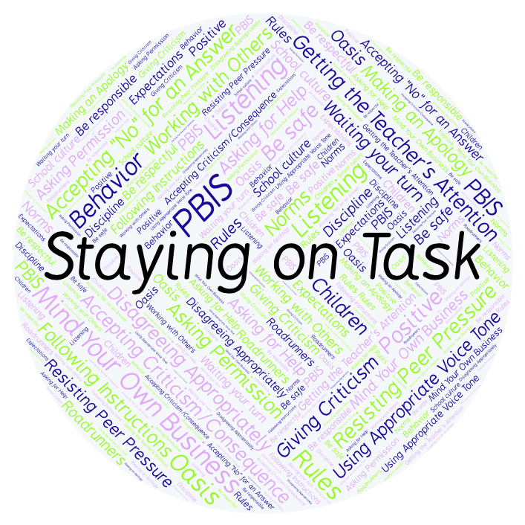
PBIS Social Skills
Day 5

Slide 2
Staying on Task
Remember, this week we are talking about Staying on Task.
Let’s review the five steps.

Slide 3
Staying on Task
Step 1: Look at your task or assignment.

Slide 4
Staying on Task
Step 2: Think about the steps needed to complete the task.
What are my
next steps?

Slide 5
Staying on Task
Step 3: Focus all of your attention on the task.

Slide 6
Staying on Task
Step 4: Stop working only when instructed.
Keep
Working!

Slide 7
Staying on Task
Step 5: Ignore distractions and interruptions.

Slide 8
Staying on Task
When you are able to demonstrate Saying on Task appropriately you have a better chance of completing your assignments on time.
Okay, today we are going to present the Projects we have been working on this week. Who would like to be the first volunteer?

