Slide 1
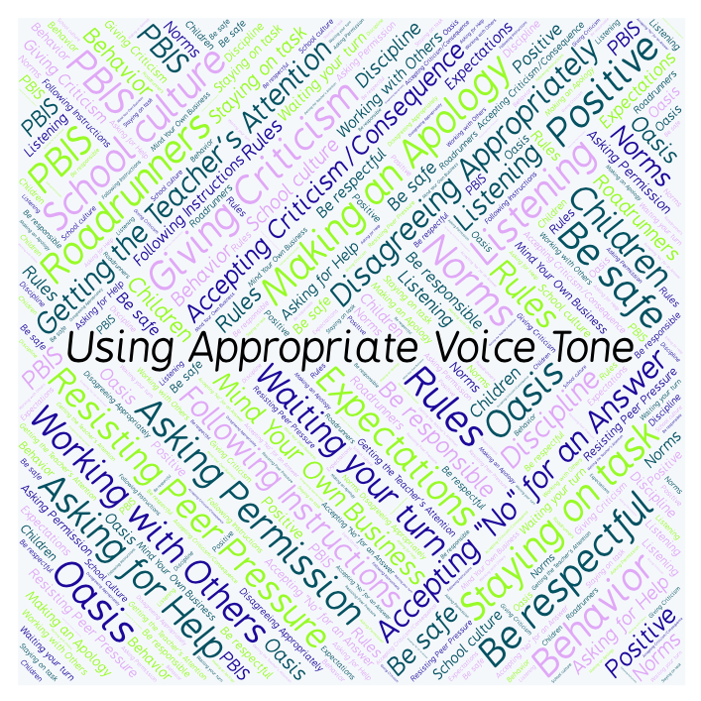
PBIS Social Skills
Day 1

Slide 2
Using Appropriate Voice Tone
When is it okay to use a loud voice? When should you use a whisper tone?
To respond to the prompt, scan the QR code to the right from the Padlet app or click here.
Once you have opened the Padlet, click on the plus sign ( + ) in the bottom right hand corner and enter your response.
Look around the Padlet to see what others have said.

Slide 3
Using Appropriate Voice Tone
This week we are going to talk about Using Appropriate Voice Tone.
Let’s learn the three steps all students must do to use appropriate voice tone.

Slide 4
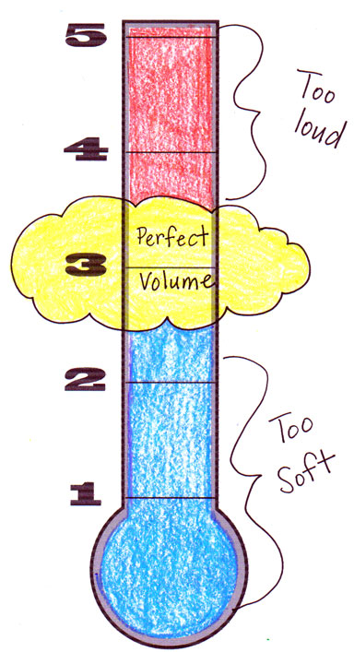
Using Appropriate Voice Tone
Step 1: Identify the appropriate voice tone for the situation.

Slide 5
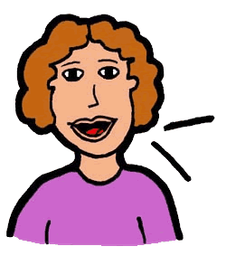
Using Appropriate Voice Tone
Step 2: Change your voice to match.

Slide 6
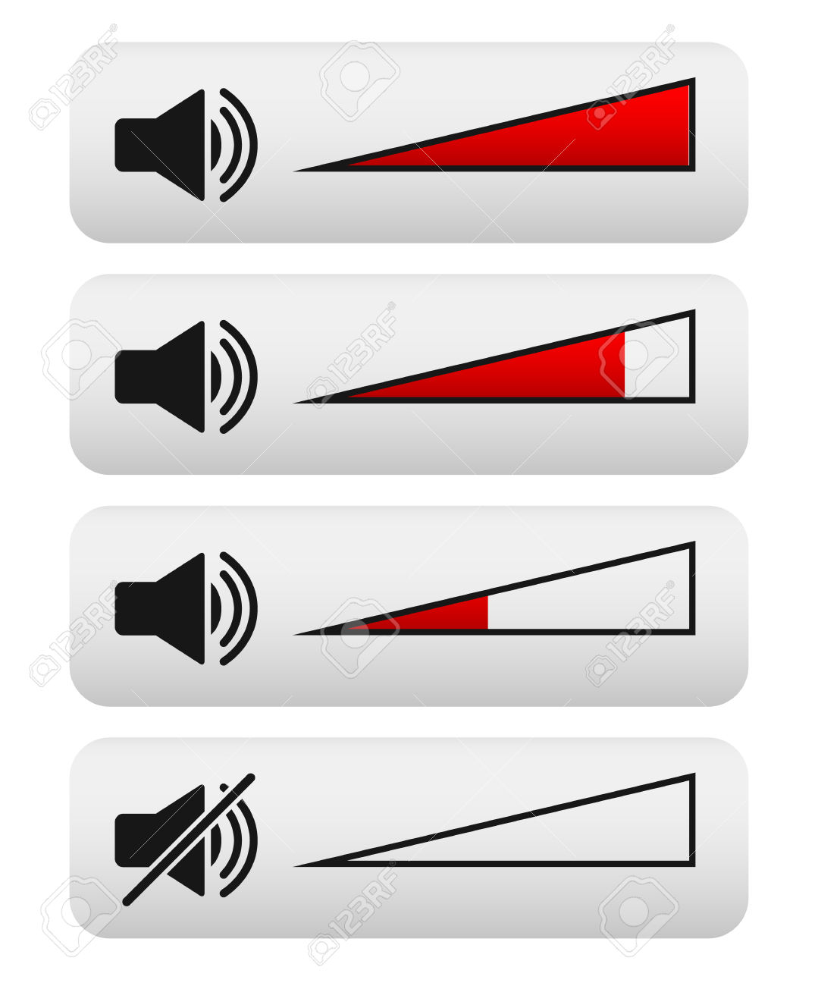
Using Appropriate Voice Tone
Step 3: Watch and listen for visual or verbal cues and adjust your voice as needed.

Slide 7
Using Appropriate Voice Tone
We will be practicing these steps all week.
When you are able to demonstrate Using Appropriate Voice Tone you may not disturb others.

Slide 8
Using Appropriate Voice Tone
Project of the Week
Work with your table group to create a flyer that gives details for using appropriate voice tone. Consider using Canva to create your flyer.
Be sure to include:
The three steps for using appropriate voice tone
Color, illustrations, and fancy text.
Present the flyer to your class.

