Slide 1
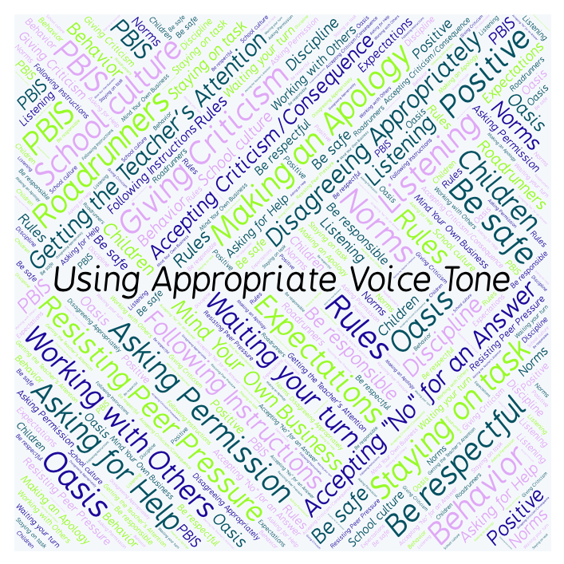
PBIS Social Skills
Day 2

Slide 2
Using Appropriate Voice Tone
Remember, this week we are talking about Using Appropriate Voice Tone.
Let’s review the three steps.

Slide 3
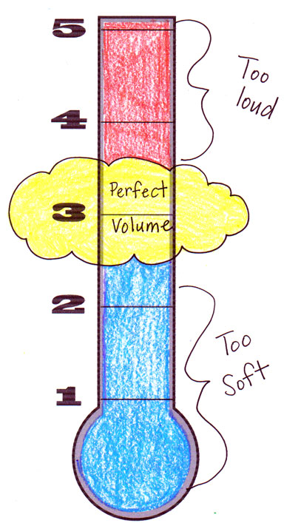
Using Appropriate Voice Tone
Step 1: Identify the appropriate voice tone for the situation.

Slide 4
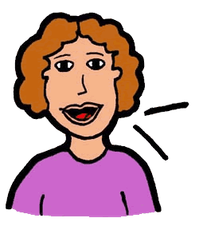
Using Appropriate Voice Tone
Step 2: Change your voice to match.

Slide 5
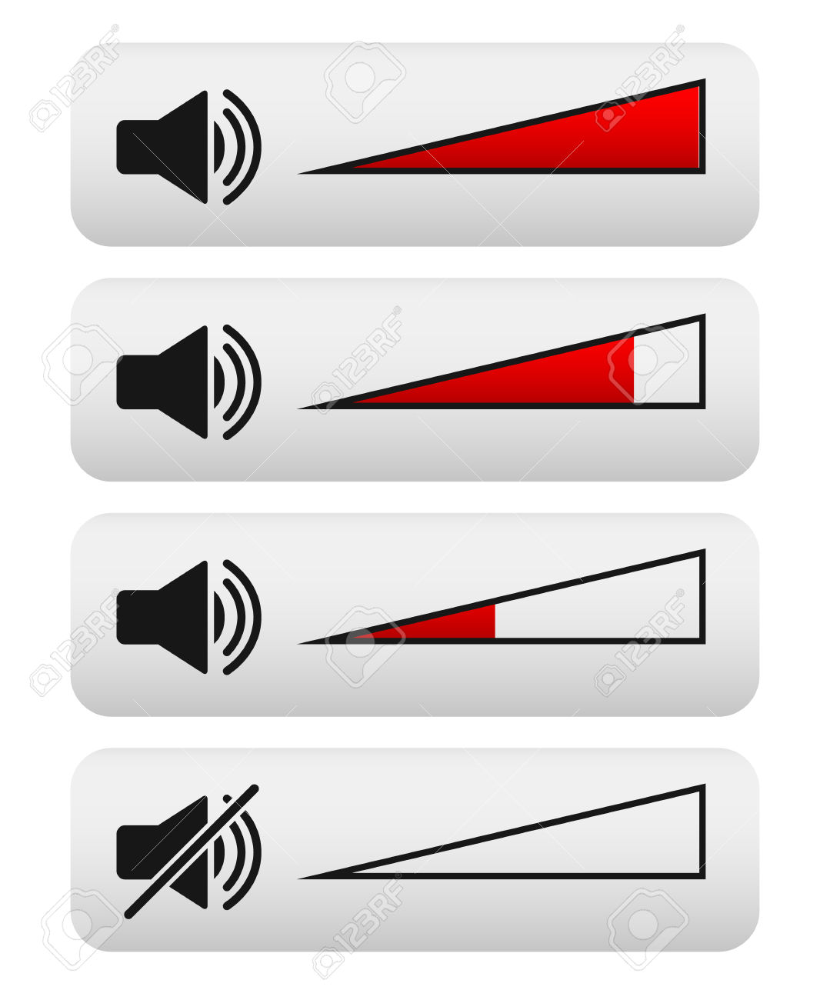
Using Appropriate Voice Tone
Step 3: Watch and listen for visual or verbal cues and adjust your voice as needed.

Slide 6
Using Appropriate Voice Tone
When you are able to demonstrate Using Appropriate Voice Tone you may not disturb others.
Okay, today we are going to talk more about the first step.
Step 1 is “Identify the appropriate voice tone for the situation.”

Slide 7
Using Appropriate Voice Tone
What do you think it means to identify the appropriate voice tone for the situation? Why is it important?
Turn to your elbow partner and discuss step 1.

Slide 8
Using Appropriate Voice Tone
What do you think would happen if you didn’t identify the appropriate voice tone for the situation?
Turn to your elbow partner and discuss the question.

Slide 9
Using Appropriate Voice Tone
Let’s learn more about using the appropriate voice tone.

Slide 10
Using Appropriate Voice Tone
Have a discussion with your elbow partner:
Describe three things you learned from the video you just watched? Which level voice would you use with partner talk?
Which step in using appropriate voice tone do you think you need to work on the most? Why?

Slide 11
Using Appropriate Voice Tone
Project of the Week
Work with your table group to create a flyer that gives details for using appropriate voice tone. Consider using Canva to create your flyer.
Be sure to include:
The three steps for using appropriate voice tone
Color, illustrations, and fancy text.
Present the flyer to your class.

