Slide 1
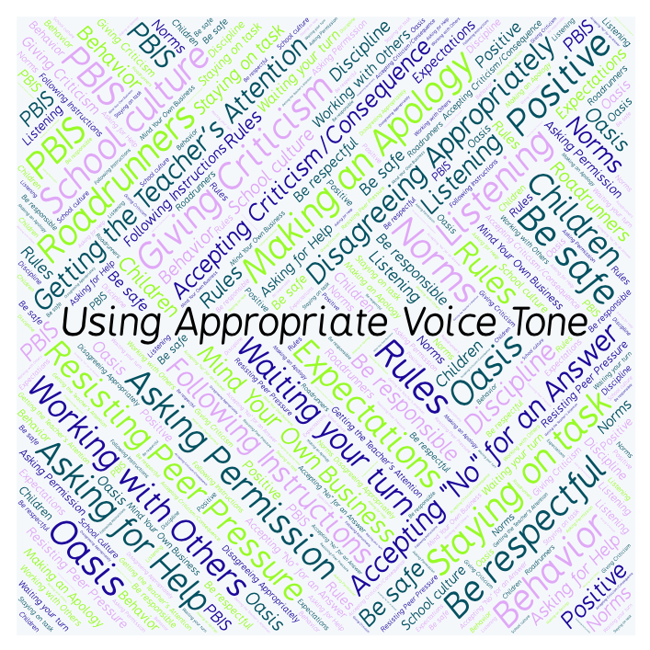
PBIS Social Skills
Day 3

Slide 2
Using Appropriate Voice Tone
Remember, this week we are talking about Using Appropriate Voice Tone.
Let’s review the three steps.

Slide 3
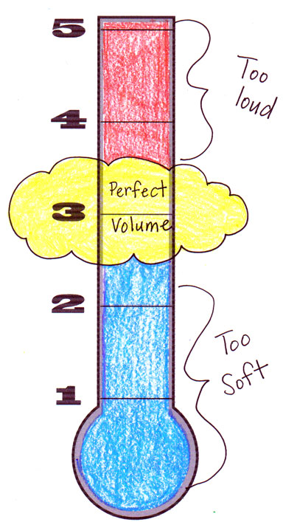
Using Appropriate Voice Tone
Step 1: Identify the appropriate voice tone for the situation.

Slide 4
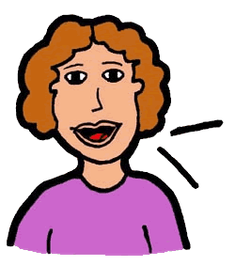
Using Appropriate Voice Tone
Step 2: Change your voice to match.

Slide 5
Using Appropriate Voice Tone
Step 3: Watch and listen for visual or verbal cues and adjust your voice as needed.

Slide 6
Using Appropriate Voice Tone
When you are able to demonstrate Using Appropriate Voice Tone you may not disturb others.
Okay, today we are going to talk more about the second step.
Step 2 is “Change your voice to match.”

Slide 7
Using Appropriate Voice Tone
Why do you think it is important to change your voice to the appropriate level for each situation?
Who would like to come to the front of the classroom and practice step 2 by using a presentation voice?

Slide 8
Using Appropriate Voice Tone
What do you think would happen if you didn’t change your voice to the appropriate level for each situation?
Who would like to come to the front of the classroom and demonstrate a non-example of a presentation voice?

Slide 9
Using Appropriate Voice Tone
Work in groups on a laptop to write an Acrostic Poem about using appropriate voice tone.
Consider using the ReadWriteThink program to compose your poem.
When you are finished, please print the final poem or email it to your teacher.

Slide 10
Using Appropriate Voice Tone
Project of the Week
Work with your table group to create a flyer that gives details for using appropriate voice tone. Consider using Canva to create your flyer.
Be sure to include:
The three steps for using appropriate voice tone
Color, illustrations, and fancy text.
Present the flyer to your class.

