Slide 1
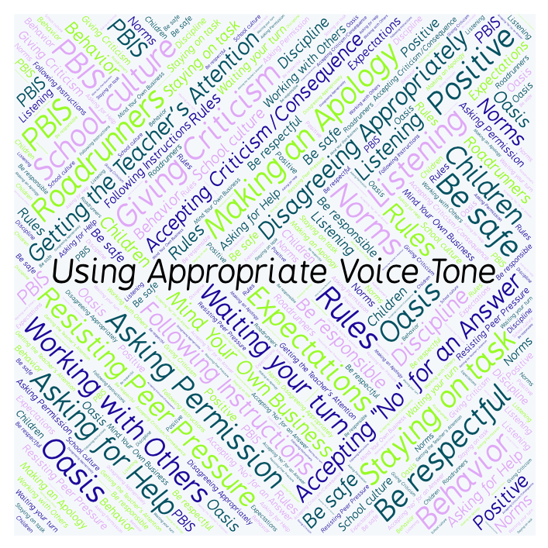
PBIS Social Skills
Day 4

Slide 2
Using Appropriate Voice Tone
Remember, this week we are talking about Using Appropriate Voice Tone.
Let’s review the three steps.

Slide 3
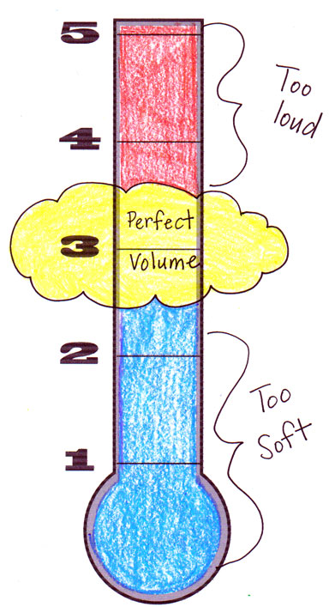
Using Appropriate Voice Tone
Step 1: Identify the appropriate voice tone for the situation.

Slide 4
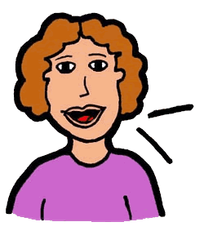
Using Appropriate Voice Tone
Step 2: Change your voice to match.

Slide 5
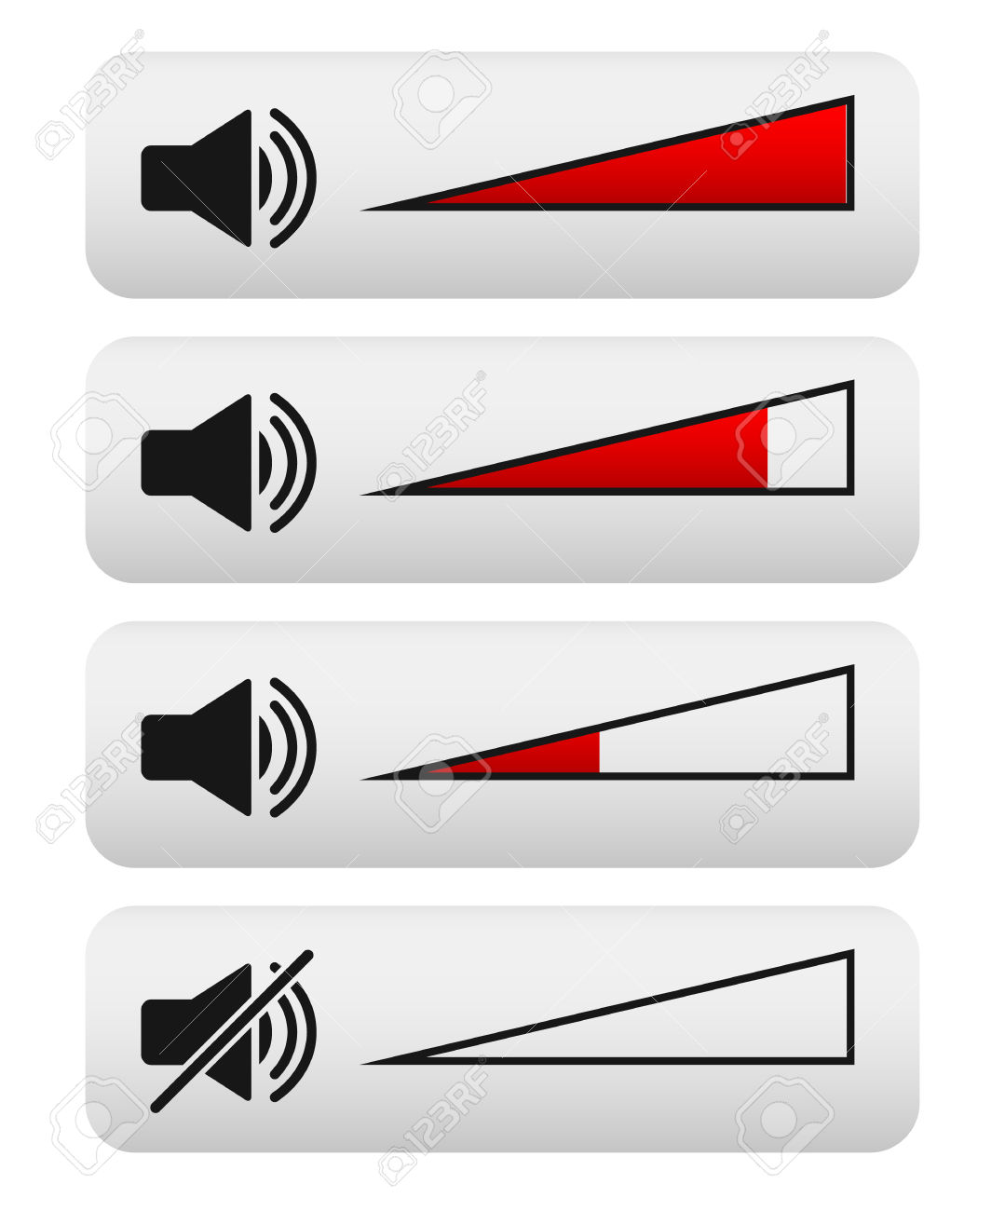
Using Appropriate Voice Tone
Step 3: Watch and listen for visual or verbal cues and adjust your voice as needed.

Slide 6
Using Appropriate Voice Tone
When you are able to demonstrate Using Appropriate Voice Tone you may not disturb others.
Okay, today we are going to talk more about the third step.
Step 3 is “Watch and listen for visual or verbal cues and adjust your voice as needed.”

Slide 7
Using Appropriate Voice Tone
Why do you think it is important to pay attention to cues and adjust your voice? What kinds of visual cues might you see? What kinds of verbal cues might you hear?
Turn to your elbow partner and discuss step 3.

Slide 8
Using Appropriate Voice Tone
What do you think would happen if you didn’t pay attention to cues and adjust your voice?
Turn to your elbow partner and demonstrate a non-example of this step.

Slide 9
Using Appropriate Voice Tone
Log in to Edmodo and navigate to the “PBIS Social Skills” group If you haven’t already joined, the code is w483zg.
Find the “Using Appropriate Voice Tone Discussion Prompt” and respond in writing by clicking on the Reply button.

Slide 10
Using Appropriate Voice Tone
Project of the Week
Work with your table group to create a flyer that gives details for using appropriate voice tone. Consider using Canva to create your flyer.
Be sure to include:
The three steps for using appropriate voice tone
Color, illustrations, and fancy text.
Present the flyer to your class.

