Slide 1
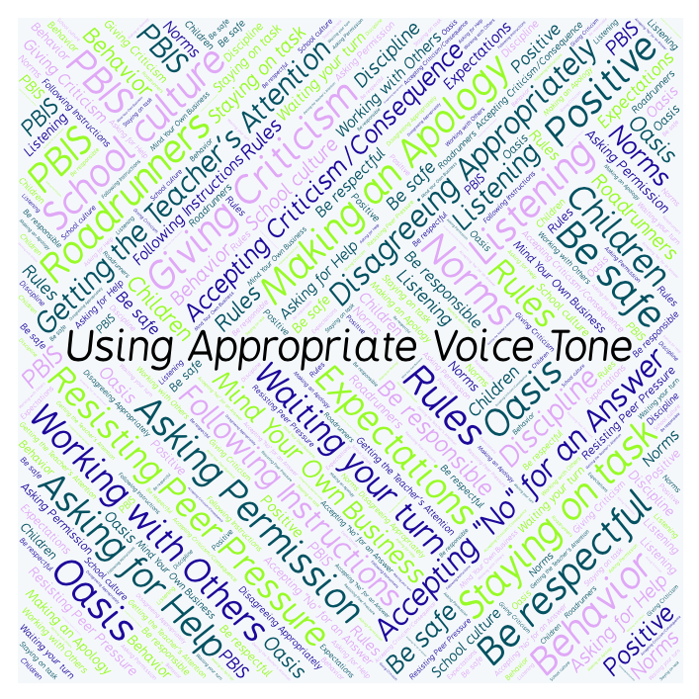
PBIS Social Skills
Day 5

Slide 2
Using Appropriate Voice Tone
Remember, this week we are talking about Using Appropriate Voice Tone.
Let’s review the three steps.

Slide 3
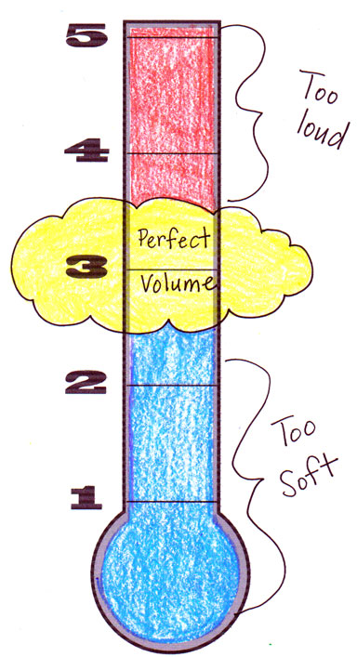
Using Appropriate Voice Tone
Step 1: Identify the appropriate voice tone for the situation.

Slide 4
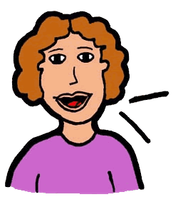
Using Appropriate Voice Tone
Step 2: Change your voice to match.

Slide 5
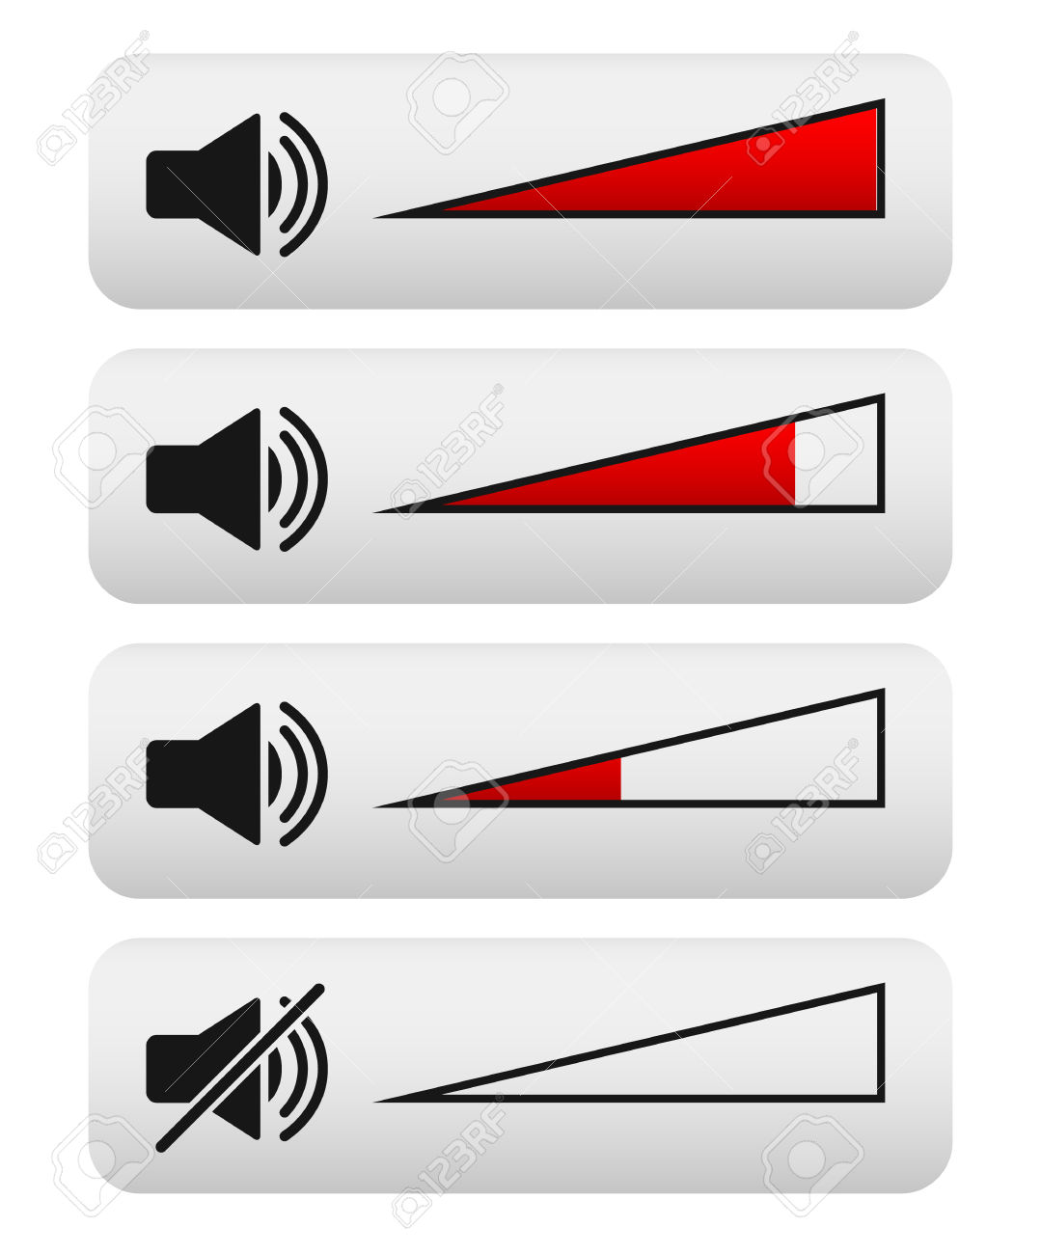
Using Appropriate Voice Tone
Step 3: Watch and listen for visual or verbal cues and adjust your voice as needed.

Slide 6
Using Appropriate Voice Tone
When you are able to demonstrate Using Appropriate Voice Tone you may not disturb others.
Okay, today we are going to present the Projects we have been working on this week.

