Slide 1
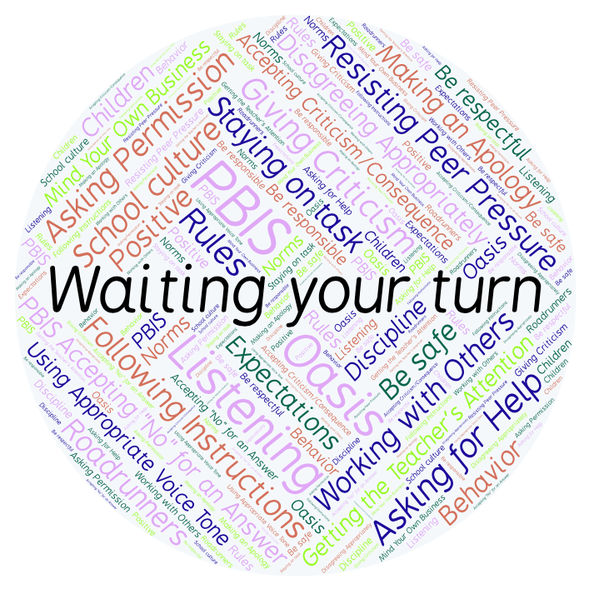
PBIS Social Skills
Day 4

Slide 2
Waiting Your Turn
Remember, this week we are talking about Waiting Your Turn.
Let’s review the five steps.

Slide 3
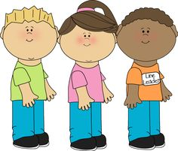
Waiting Your Turn
Step 1: Sit or stand quietly.

Slide 4
Waiting Your Turn
Step 2: Keep your arms and legs still.

Slide 5
Waiting Your Turn
Step 3: Avoid begging, whining, or teeth sucking.

Slide 6
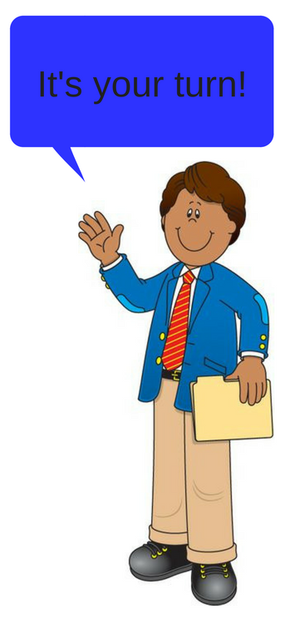
Waiting Your Turn
Step 4: Engage in the activity when directed by an adult to do so.

Slide 7
Waiting Your Turn
Step 5: Thank the person who gives you a turn.

Slide 8
Waiting Your Turn
When you are able to demonstrate Waiting Your Turn everyone may have a chance to share their ideas.
Okay, today we are going to talk more about the fifth step.
Step 5 is “Thank the person who gives you a turn.”

Slide 9
Waiting Your Turn
Why do you think it is important to thank the person who gives you a turn? What words could you use to express your gratitude?
Turn to your elbow partner and practice step 5.

Slide 10
Waiting Your Turn
What do you think would happen if you didn’t thank the person who gave you a turn?
Turn to your elbow partner and demonstrate a non-example of this step.

Slide 11
Waiting Your Turn
Log in to Edmodo and navigate to the “PBIS Social Skills” group. If you haven’t already joined, the code is w483zg.
Find the “Waiting Your Turn Discussion Prompt” and respond in writing by clicking on the Reply button.

Slide 12
Waiting Your Turn
Project of the Week
Work with your table group to create a flipbook that shows how to wait your turn. Consider creating your flipbook using the ReadWriteThink app on your iPad.
Be sure to include:
The five steps you learned for waiting your turn.
An explanation for each step.
An illustration for each step.
Present the flipbook to your class.

