Slide 1
PBIS Social Skills
Day 1

Slide 2
Working with Others
Tell about a time you had to work in a group. What was the best part? What was challenging?
To respond to the prompt, scan the QR code to the right from the Padlet app or click here.
Once you have opened the Padlet, click on the plus sign ( + ) in the bottom right hand corner and enter your response.
Look around the Padlet to see what others have said.

Slide 3
Working with Others
This week we are going to talk about Working with Others.
Let’s learn the four steps all students must do when asked to work with others.

Slide 4
Working with Others
Step 1: Identify the task to be completed.

Slide 5
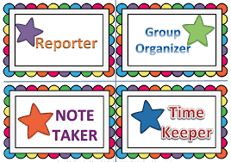
Working with Others
Step 2: Assign tasks to each person.

Slide 6
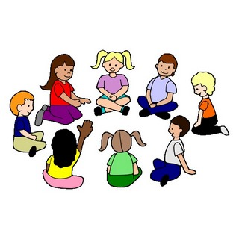
Working with Others
Step 3: Discuss ideas in a calm, quiet voice and let everyone share their ideas.

Slide 7
Working with Others
Step 4: Work on tasks until completed.

Slide 8
Working with Others
We will be practicing these steps all week.
When you are able to work with others in this way, you have a better chance to complete the assignment.

Slide 9
Working with Others
Project for the Week
Work with your table group to create a comic strip about working with others
Be sure to include:
The four steps you learned for Working with Others.
Characters and dialog.
Plan your comic strip by deciding how many characters there will be, what situation they will be in, and what they will say. Consider creating the final comic strip using the ReadWriteThink comic creator

