Slide 1
PBIS Social Skills
Day 2

Slide 2
Working with Others
Remember, this week we are talking about Working with Others.
Let’s review the four steps.

Slide 3
Working with Others
Step 1: Identify the task to be completed.

Slide 4
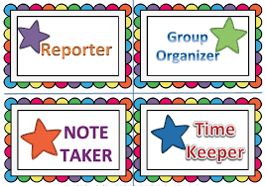
Working with Others
Step 2: Assign tasks to each person.

Slide 5
Working with Others
Step 3: Discuss ideas in a calm, quiet voice and let everyone share their ideas.

Slide 6
Working with Others
Step 4: Work on tasks until completed.

Slide 7
Working with Others
When you are able to work with others in this way, you have a better chance to complete the assignment.
Okay, today we are going to talk more about the first step.
Step 1 is “Identify the task to be completed.”

Slide 8
Working with Others
Why do you think it is important to identify the task to be completed? How would you do this?
Turn to your elbow partner and practice step 1.

Slide 9
Working with Others
What do you think would happen if you didn’t identify the task to be completed?
Turn to your elbow partner and demonstrate a non-example of this step.

Slide 10
Working with Others
Let’s watch some students learn how to work with others.

Slide 11
Working with Others
Have a discussion with your elbow partner:
How did the characters in the movie you just watched demonstrate the four steps to working with others that we have learned?
Which step do you think you need to work on the most? Why?

Slide 12
Working with Others
Project for the Week
Work with your table group to create a comic strip about working with others
Be sure to include:
The four steps you learned for Working with Others.
Characters and dialog.
Plan your comic strip by deciding how many characters there will be, what situation they will be in, and what they will say. Consider creating the final comic strip using the ReadWriteThink comic creator

